Slide 1
Danish Association for Flexible Learning & e-learning
(FLUID)
Building the skills planning model
Chris Brodie
Lead Head of Sector
Development
24th September
2014

Slide 2
Why are we doing SIPs and RSAs?
Skills system
Emphasis on skills as a driver of economic growth, as well as tool to address youth unemployment
Call from employers for skills provision to better align with employer demand
College Regionalisation and University Outcome Agreements
Needs to be supported by high quality evidence on employers demand for skills
Economic / agency context
Huge economic and sectoral changes
And employers skills needs change increasingly fast.
Infrastructure to generate evidence been diminished
  SSC’s LMI less consistent in Scotland
  Loss of Local Enterprise Companies
  Closure of Lothian LMI Unit, Tayside Economic Research, SLIMS, Futureskills
Notes:
Note on history

Slide 3
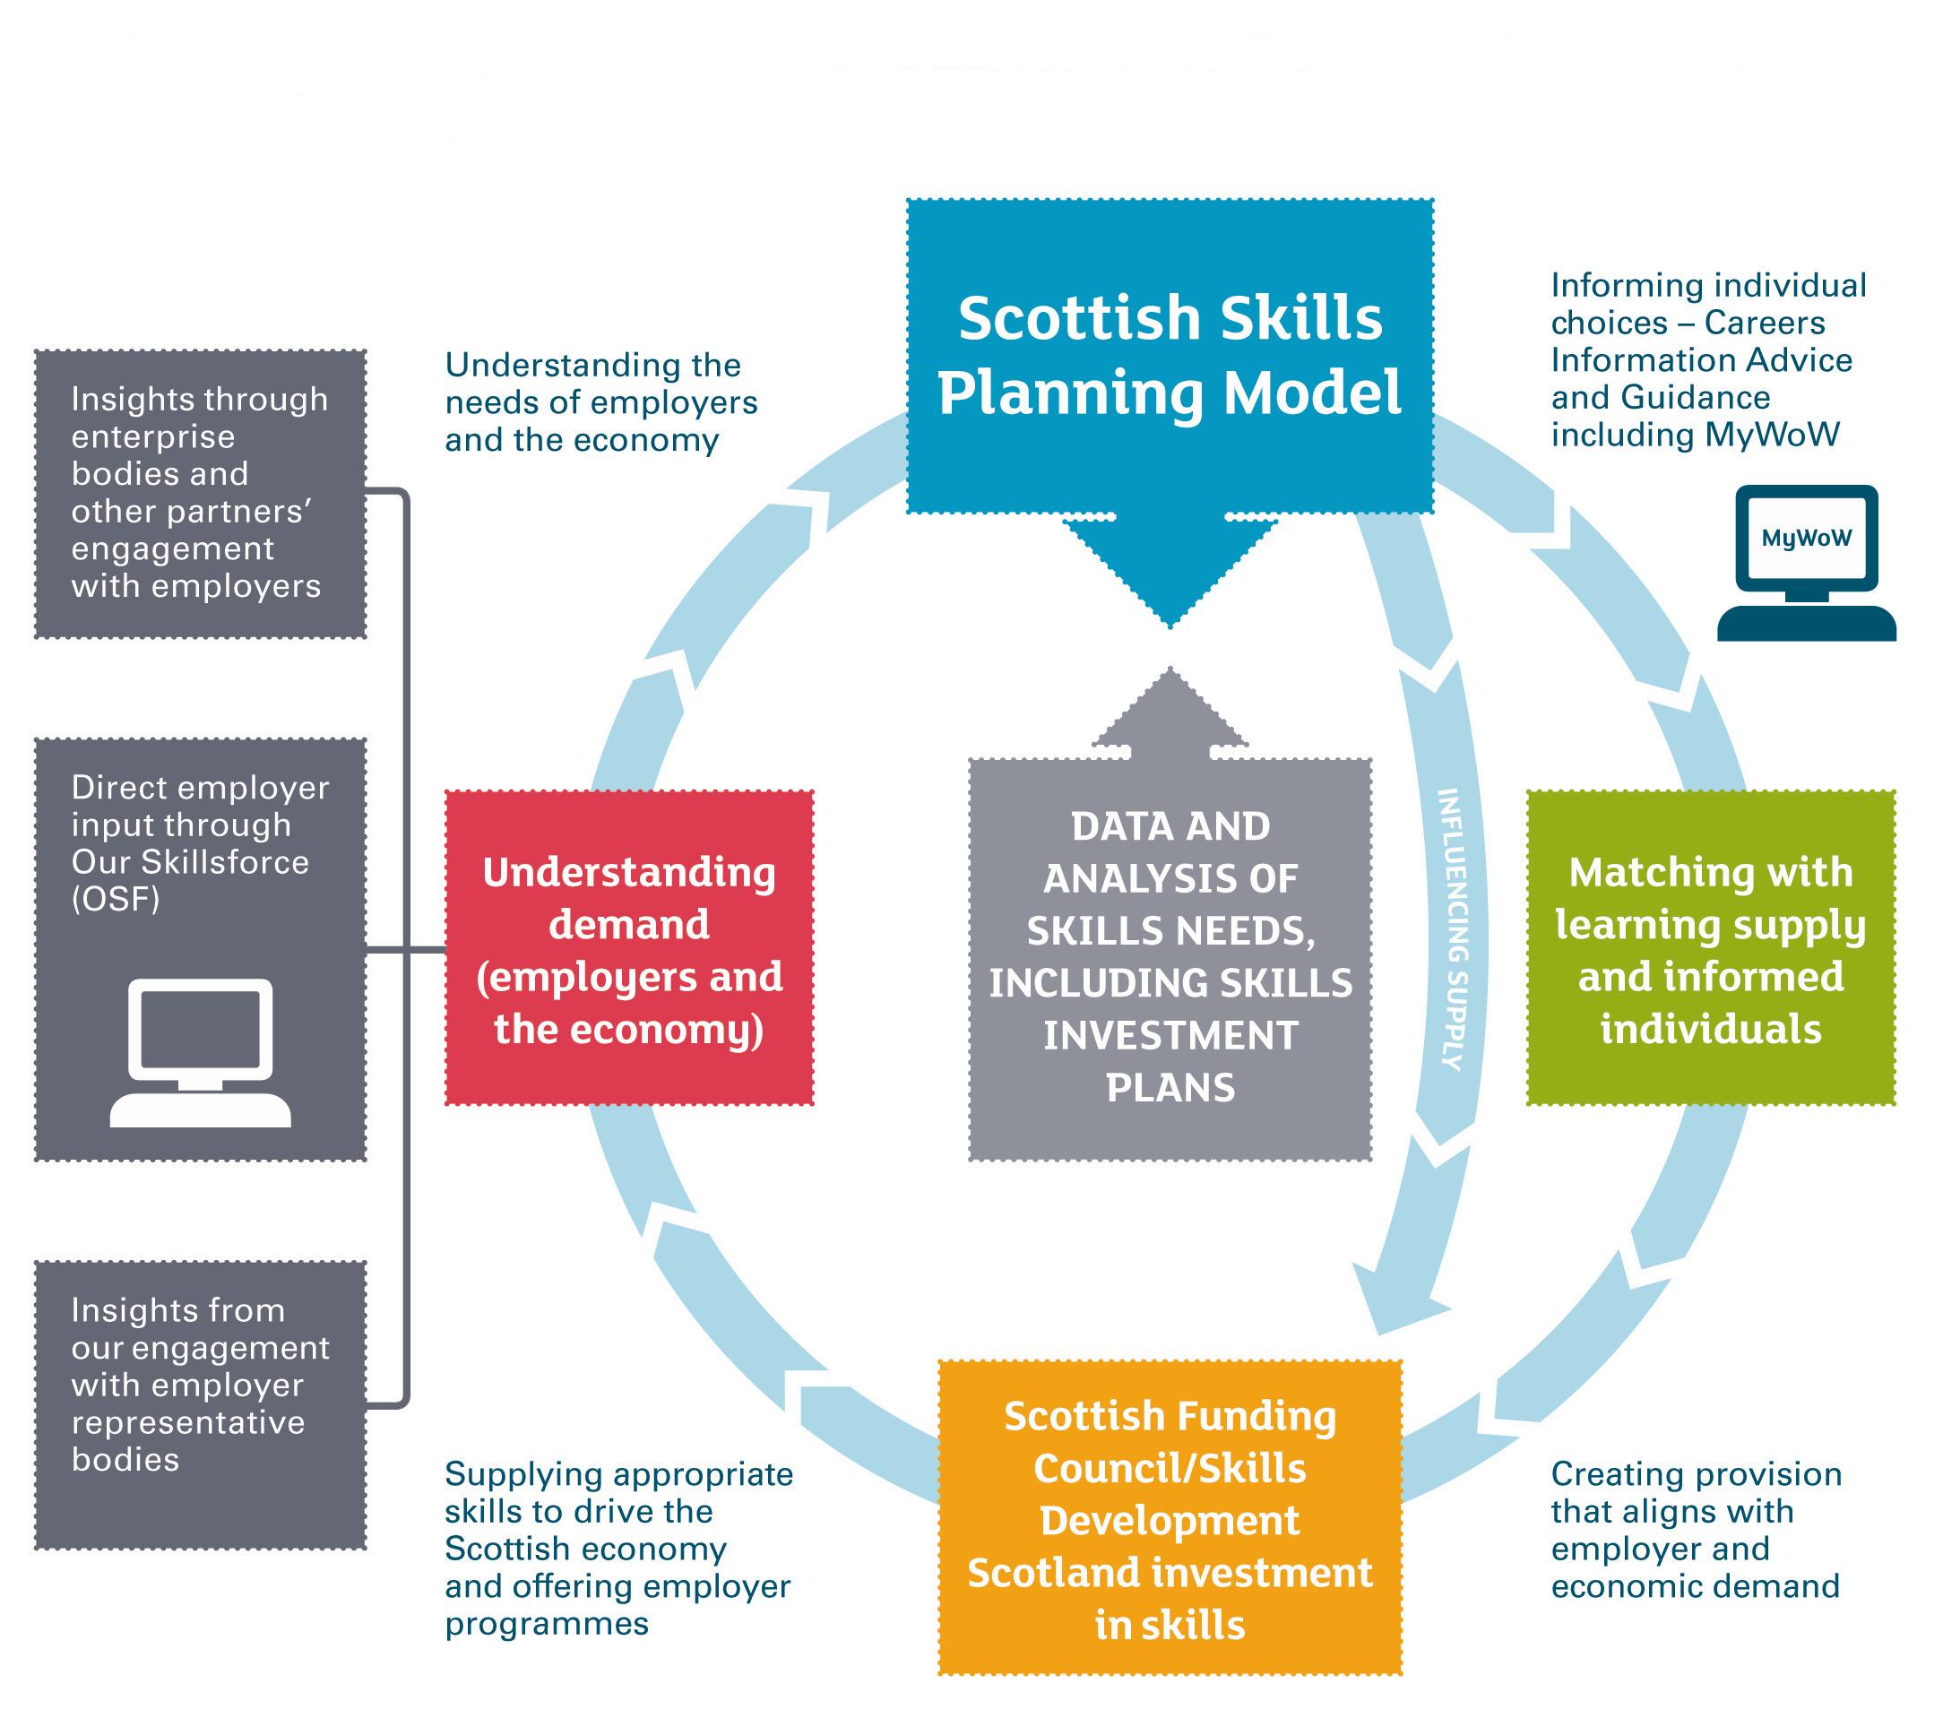

Slide 4
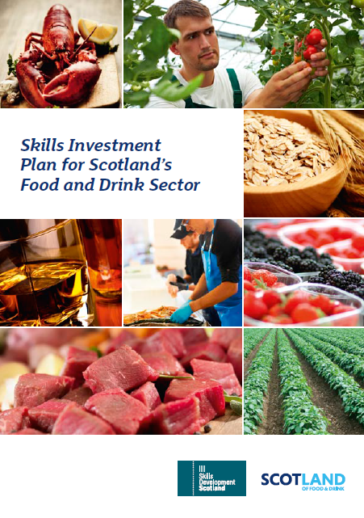

Sector Development Team (20 staff)
Gathering intelligence and insight on the skills requirements of employers:
  Labour market intelligence
  Working with employers & industry leadership groups
Prioritising skills development needs in sectors & regions:
  10 Skills Investment Plans (6 Key sectors + ICT, Engineering, Construction and Chemicals)
  11 Regional Skills Assessments (Aligned with Regional Colleges)
Influencing the supply side
  Provide the ‘unified skills narrative’
  Engage with Industry and Govt Agencies to produce plans
  Inform SDS service delivery (NTPs, MyWoW, OSF)

Slide 5
Partner engagement
Scale of the sector
/ growth ambition
Enterprise Agencies (SE / HIE)
Review evidence
of skills needs
Sector Skills Councils
Gap filling
Identify skills
priorities for growth
Industry Leadership Groups
Test with
industry
Scottish Funding Council / SDS
Assess supply
side constraints
Secure buy-in for
SIP Actions
ILG Skills Group
(50% Industry and 50% Govt agencies)
Publish SIP
+ Action Plan
Notes:
38.6% of vcancies are HTF v 35.2 in all industries
HTF = 0..7% of all jobs in the sector (v 0.5% in all industries)
SS = 0.5% of all job – same as other industries

Slide 6
What do SIPs talk about
What’s driving growth and change in the sector
Sector attractiveness (esp. to young people)
Skills gaps and skills shortages – and where employers are finding it hard to recruit
What’s coming out of the system (Universities, Colleges, Modern Apprenticeships, Schools)
Employer views of skills system (Quantity, Quality, Right skills?)
Importance of international talent attraction
Employers recruitment practices
Notes:
38.6% of vcancies are HTF v 35.2 in all industries
HTF = 0..7% of all jobs in the sector (v 0.5% in all industries)
SS = 0.5% of all job – same as other industries

Slide 7
Regional Skills Assessments

Slide 8
Purpose of Regional Skills Assessments
SDS, SFC and SE partnership
Provide a single, agreed evidence base on which to plan future investment in skills, built up from existing evidence
RSAs should:
  Support SFC and Regional Colleges in negotiating Regional Outcome Agreements
  Provide a framework for aligning SDS investment in individuals and businesses
  Assist partners in planning their strategic investment in skills
  Highlight gaps in evidence base and provide frame for addressing

Slide 9
How did we develop RSAs?
Four principles have informed the development of RSAs
‘Useful’ content – and taking a holistic view beyond simply ‘skills’
Extensive partner and ‘customer’ engagement
Reflect Scotland’s different economic geographies
It’s an assessment – not a plan

Slide 10
Engagement
Stage 1
Data collation and share with Regional Colleges October/November 2013
Stage 2
Internal (SDS / SE / SFC) Consultations
December to January 2014
Stage 3
Production of RSAs
May/June 2014
Wider Partner Consultations (individual and group)
February to March 2014
Stage 5
Stage 4
Lessons Learned
Review of the process and measuring effectiveness

Slide 11
 | RSA Region | Unitary Authorities | Economic Forum | College ROA
1 | Aberdeen City and Shire | Aberdeen City | ACSEF
 |  | Aberdeenshire |  | Aberdeen/Aberdeenshire
2 | Ayrshire | East Ayrshire | West RAB Ayrshire Economic Partnership | Ayrshire
 |  | North Ayrshire
 |  | South Ayrshire
3 | Edinburgh and Lothians | East Lothian | East RAB | Edinburgh and Lothians/West Lothian
 |  | Edinburgh City
 |  | Midlothian
 |  | West Lothian
4 | Fife | Fife | East RAB | Fife
5 | Forth Valley | Clackmannanshire | East RAB/ Forth Valley Forum | Forth Valley
 |  | Falkirk
 |  | Stirling
6 | Lanarkshire | North Lanarkshire | West RAB/ Glasgow Economic Leadership | Lanarkshire
 |  | South Lanarkshire
 |  | East Dunbartonshire*
7 | Glasgow | Glasgow |  | Glasgow
8 | West | East Renfrewshire* |  | West
 |  | Inverclyde
 |  | Renfrewshire
 |  | West Dunbartonshire
9 | South of Scotland | Dumfries & Galloway | South of Scotland RAB | Dumfries & Galloway/Borders
 |  | Scottish Borders
10 | Tayside | Angus | Tayside RAB | Tayside/Highlands and Islands
 |  | Dundee City
 |  | Perth & Kinross

Slide 13
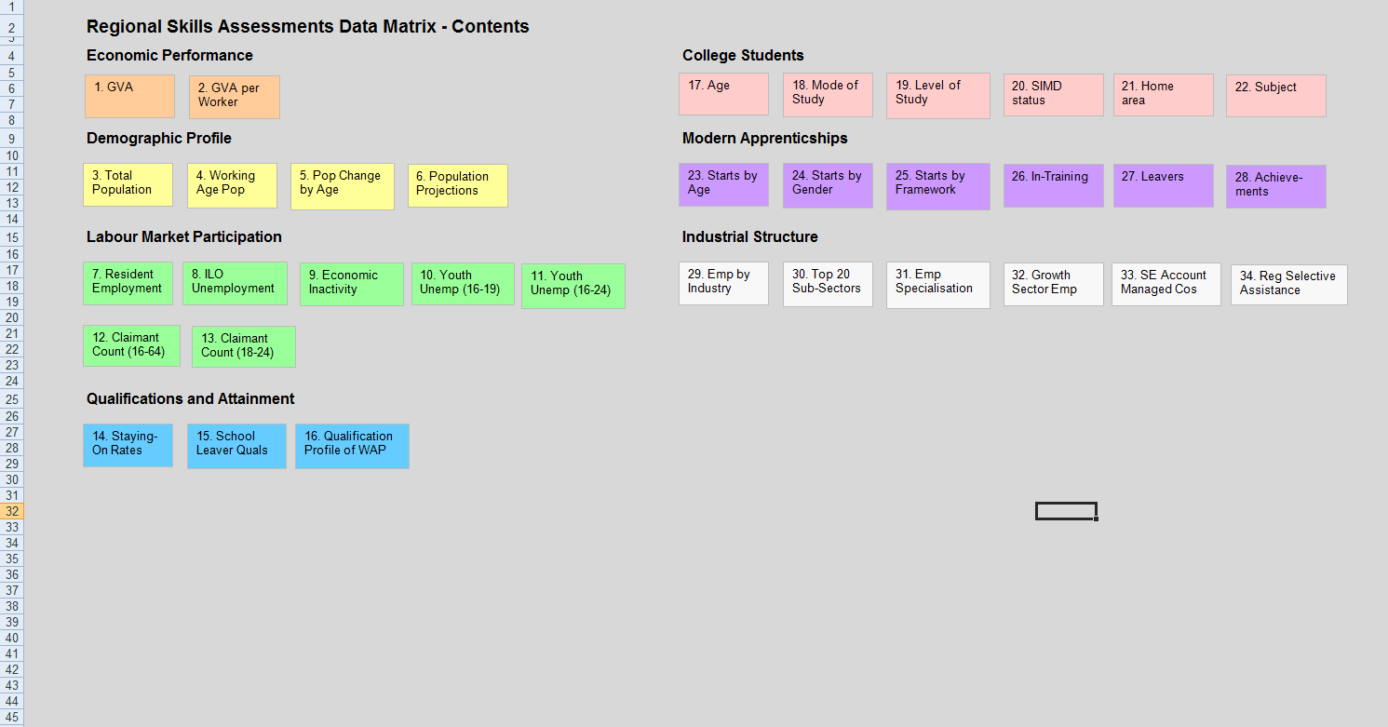
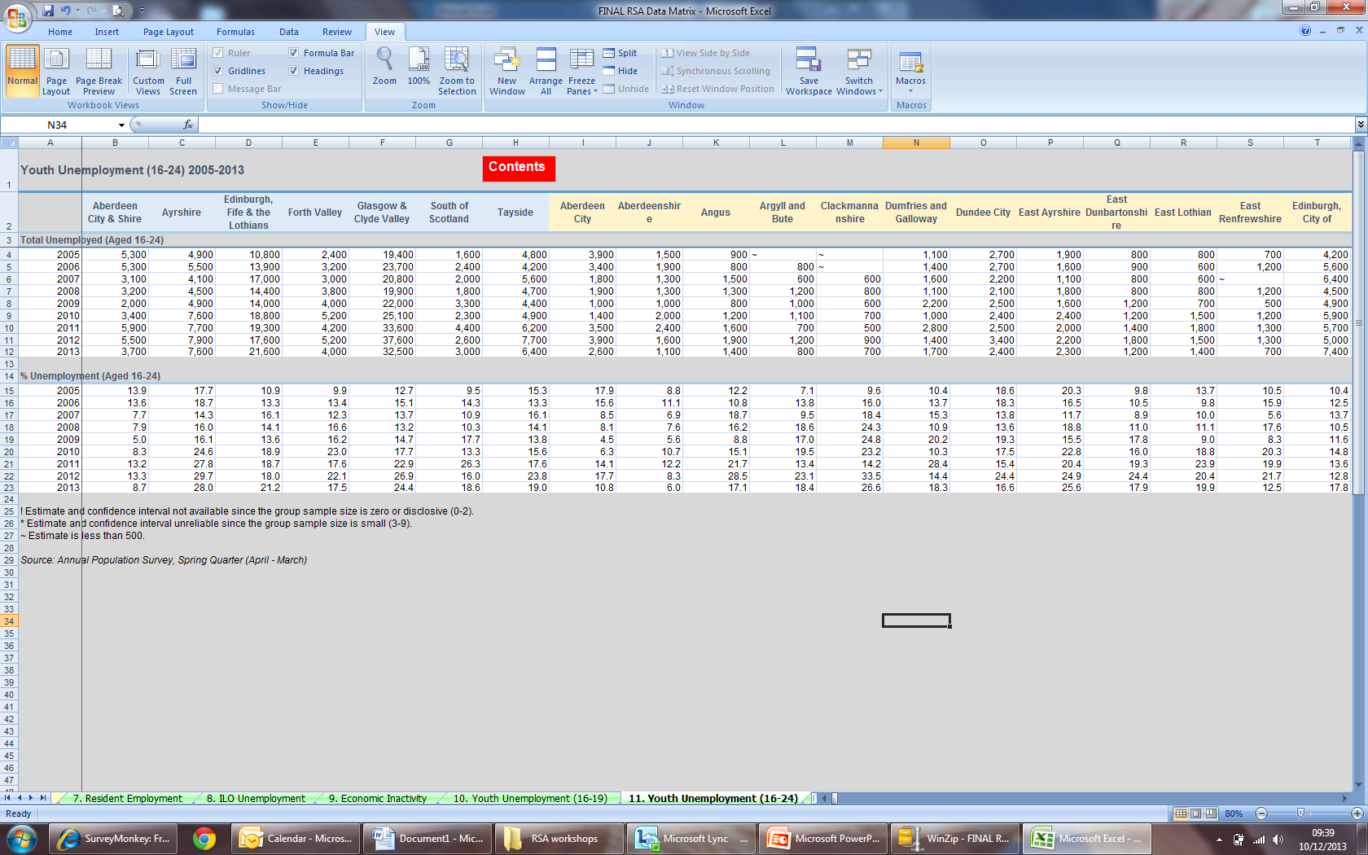

Regional Skills Assessments – Data Matrix

