Slide 1
Educational Development Unit
Scott Connor
Educational Development Leader
Perth College UHI
25th September 2014
Notes:
In the next 10 – 15 minutes:
Quick tour of the EDU, what we do and who we are (apologies for repetition for those of you who know us well)
Where you can find more information about us
Overview of what we produce
Time for Q and A

Slide 2
Overview
Key aims of the EDU
How the EDU works
Technology used in UHI
Web 2.0 technologies
What does TEL offer
Examples of materials
Considerations
Questions
Notes:
Technology – Synchronous/Asynchronous mix, used to deliver our vision

Slide 3
Key aims of the EDU
To enhance the student experience through the increased use of blended learning.
To enhance areas of the curriculum by developing new blended learning teaching resources in collaboration with relevant stakeholders.
To develop staff in the delivery and modification of the new blended learning teaching resources.
To increase employer satisfaction with the skills of UHI graduates by engaging them in the curriculum development process.
Notes:
Linked to our vision and developed by the team at the start of the EDU in 2011.
Adhered to since then and used to measure our impact against.

Slide 4
How we work
The core EDU team of 12

Slide 5
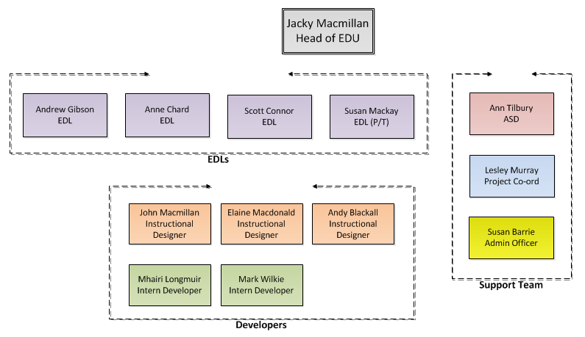
The Team
The core EDU team of 12

Slide 6
The Team
The core EDU team of 12

Slide 7
How we work
The core EDU team of 12
Dispersed across the academic partner colleges
Essential to use technology to work together (VC, Jabber, Lync, Dropbox)
Pioneer shared working tools – UHI Toolkit
Often a conduit for cross curriculum / cross Academic Partner communication – Induction Project

Slide 8
Technology in UHI
E-Portfolio
Video Conferencing
Collaboration
Document
Sharing
Desktop Sharing
Text Chat
Wiki
Social Networking
Audio Streaming
Content Hosting
Blog
Email
Video Streaming
Discussion

Slide 9
Technology in UHI
Mahara
E-Portfolio
Video Conferencing
Collaboration
Document
Sharing
Desktop Sharing
Text Chat
Wiki
Social Networking
Audio Streaming
Content Hosting
Blog
Email
Video Streaming
Discussion

Slide 10
Technology in UHI
Blackboard VLE
E-Portfolio
Video Conferencing
Collaboration
Document
Sharing
Desktop Sharing
Text Chat
Wiki
Social Networking
Audio Streaming
Content Hosting
Blog
Email
Video Streaming
Discussion

Slide 11
Technology in UHI
Lync
E-Portfolio
Video Conferencing
Collaboration
Document
Sharing
Desktop Sharing
Text Chat
Wiki
Social Networking
Audio Streaming
Content Hosting
Blog
Email
Video Streaming
Discussion

Slide 12
Technology in UHI
Jabber
E-Portfolio
Video Conferencing
Collaboration
Document
Sharing
Desktop Sharing
Text Chat
Wiki
Social Networking
Audio Streaming
Content Hosting
Blog
Email
Video Streaming
Discussion

Slide 13
Technology in UHI
Helix
E-Portfolio
Video Conferencing
Collaboration
Document
Sharing
Desktop Sharing
Text Chat
Wiki
Social Networking
Audio Streaming
Content Hosting
Blog
Email
Video Streaming
Discussion

Slide 14
Web 2 Technology
Foliospaces
E-Portfolio
Video Conferencing
Collaboration
Document
Sharing
Desktop Sharing
Text Chat
Wiki
Social Networking
Audio Streaming
Content Hosting
Blog
Email
Video Streaming
Discussion

Slide 15
Web 2 Technology
asana
E-Portfolio
Video Conferencing
Collaboration
Document
Sharing
Desktop Sharing
Text Chat
Wiki
Social Networking
Audio Streaming
Content Hosting
Blog
Email
Video Streaming
Discussion

Slide 16
Web 2 Technology
WikiSpaces
E-Portfolio
Video Conferencing
Collaboration
Document
Sharing
Desktop Sharing
Text Chat
Wiki
Social Networking
Audio Streaming
Content Hosting
Blog
Email
Video Streaming
Discussion

Slide 17
Web 2 Technology
Skype
Google Hang
E-Portfolio
Video Conferencing
Collaboration
Document
Sharing
Desktop Sharing
Text Chat
Wiki
Social Networking
Audio Streaming
Content Hosting
Blog
Email
Video Streaming
Discussion

Slide 18
Web 2 Technology
Vimeo
YouTube
E-Portfolio
Video Conferencing
Collaboration
Document
Sharing
Desktop Sharing
Text Chat
Wiki
Social Networking
Audio Streaming
Content Hosting
Blog
Email
Video Streaming
Discussion

Slide 19
Web 2 Technology
Facebook
E-Portfolio
Video Conferencing
Collaboration
Document
Sharing
Desktop Sharing
Text Chat
Wiki
Social Networking
Audio Streaming
Content Hosting
Blog
Email
Video Streaming
Discussion

Slide 20
Web 2 Technology
Wordpress
E-Portfolio
Video Conferencing
Collaboration
Document
Sharing
Desktop Sharing
Text Chat
Wiki
Social Networking
Audio Streaming
Content Hosting
Blog
Email
Video Streaming
Discussion

Slide 21
Web 2 Technology
BB Coursesites
E-Portfolio
Video Conferencing
Collaboration
Document
Sharing
Desktop Sharing
Text Chat
Wiki
Social Networking
Audio Streaming
Content Hosting
Blog
Email
Video Streaming
Discussion

Slide 22
Web 2 Technology
Foliospaces
E-Portfolio
Video Conferencing
Collaboration
Document
Sharing
Desktop Sharing
Text Chat
Wiki
Social Networking
Audio Streaming
Content Hosting
Blog
Email
Video Streaming
Discussion

Slide 23
Web 2 Technology
Foliospaces
E-Portfolio
Video Conferencing
Collaboration
Document
Sharing
Desktop Sharing
Text Chat
Wiki
Social Networking
Audio Streaming
Content Hosting
Blog
Email
Video Streaming
Discussion

Slide 24
Web 2 Technology
Foliospaces
E-Portfolio
Video Conferencing
Collaboration
Document
Sharing
Desktop Sharing
Text Chat
Wiki
Social Networking
Audio Streaming
Content Hosting
Blog
Email
Video Streaming
Discussion

Slide 25
Web 2 Technology
Dropbox
E-Portfolio
Video Conferencing
Collaboration
Document
Sharing
Desktop Sharing
Text Chat
Wiki
Social Networking
Audio Streaming
Content Hosting
Blog
Email
Video Streaming
Discussion

Slide 26
What does TEL offer UHI
Enhances the curriculum
Deliver across geographical boundaries
Broadens our market
Sharing of skills – collaboration
Notes:
EDU develops learning that meets all of the above.

Slide 27
So what’s involved in a typical EDU project?
Proposal &
Selection
P.I.D.
Resourcing
Project completion
Project launch
Interim Review
Peer review, feedback
Evaluation
Staff engagement
Employer engagement
6 months
Notes:
This is one life cycle but there’s usually another 3 or 4 running concurrently in a 6 month period!
Proposal
PID
Resourcing
Project launch
Project development
Staff development
Employer engagement
Interim review
Peer review, feedback and revision
MSS Borehole
Geology Earth Structure, plate tectonics
SML
Dentistry
Archaeology

Slide 28
So what do our resources look like?
Go to:
http://showcase.uhi.ac.uk/

Slide 29
Considerations
Student willingness to engage
Institutional restrictions
Staff competency
Appropriateness of technology
Differences in culture
Notes:
Student willingness to engage – especially with BYOD or use your own account (UYOA)
Institutional restrictions – on privacy and copyright – make sure enrolling students know up front what is expected of them
Staff competency – use of technology – there will be a training requirement
Appropriateness of technology
Differences in culture

Slide 30
Questions
EDU on the UHI website:
www.uhi.ac.uk/edu
EDU email address:
edu@uhi.ac.uk
EDU Showcase of materials:
http://showcase.uhi.ac.uk/
Red Question Mark, WikiCommons (2009)

