Slide 1
Marty Wright
Head of Centre; Scottish Centre for Work Based Learning (SCWBL)

Slide 2
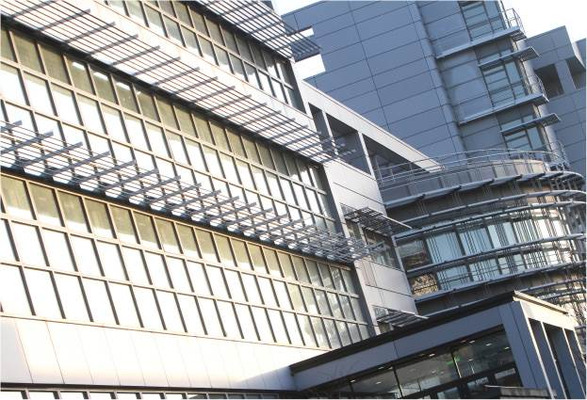
17 000 students
1 of 5 Schools
Health & Life Sciences
Business
Engineering
WORK BASED LEARNING
Graduate

Slide 3
GLASGOW CALEDONIAN UNIVERSITY
2013/14 perspective
Defines Flexible Learning as:
Recognition of Prior Learning 1422 students
Work Based Learning 850 students
Distance Learning 894 students
19 flexible learning / DL programmes (2 fully online)
3 areas not linked so may be overlap

Slide 4
Recognition of Prior Learning (RPL)
the process for recognising learning that has its source in experience and/or previous formal, non-formal and informal learning contexts. This includes knowledge and skills gained within school, college and university and outside formal learning situations, such as through life and work experiences
(Scottish Credit and Qualifications Framework (SCQF), 2009, 2010).

Slide 5
The SCQF RPL guidelines make a distinction between two forms of recognition:
RPL for personal/career development or formative recognition (N/A for SCWBL)
RPL for credit, or summative recognition.
The process of assessing learning achieved outside of formal education or training systems which is recognised, if appropriate, for academic purposes.
Enable entry to a programme if the outcomes of their prior informal learning are judged as comparable to the entry requirements of the programme
Can gain credit within a programme if the outcomes of his/her prior informal learning are judged as comparable to the outcomes of the programme to which he/she is seeking credit.
http://www.enhancementthemes.ac.uk/flexible-learning/recognition-of-prior-learning

Slide 6
Work based learning (WBL)
provides the reality of an authentic context for learning, producing currency of transferable credit. It can enrich student learning, create a well-qualified workforce and open up new markets for HEIs.
includes a wide range of provision where the focus is on situations where the main location for the student is the workplace.

Slide 7
WBL: The curriculum meets the needs of both
Employee-students in vocational areas undertaking professional qualifications part-time using their work context as a key component of their learning (NOT WORK OF SCWBL).
Employee-students undertaking general degree studies (Business / Management; Leadership / Management) using their work context for learning and assessment.
Workers undertake in-house courses that are then credit-rated towards HEI awards.
Workers undertake programmes deliberately planned to integrate learning and practice.
(http://www.qaa.ac.uk/en/AboutUs/Documents/WBL_Guidelines.pdf )

Slide 8
Distance Learning
A course of study that does not involve face-to-face contact between students and tutors but instead uses technology such as the internet, intranets, broadcast media, CD-ROM and video, or traditional methods of correspondence - learning 'at a distance'.
http://www.qaa.ac.uk/AboutUs/glossary/Pages/glossary-d.aspx#d7

Slide 9
SCWBL: Who we are and what we do
Scottish Centre for Work Based Learning
being renamed
School for Work Based Education
‘Learning at work, for work and through work’

Slide 10
what we do NOT do
We do not (currently) support work related learning through placements for professional qualifications

Slide 11
SCWBL : Work with partners
All our students are employees
Majority (95%) are undertaking bespoke degree, honours or masters level programmes with the support and financed by employers
Programmes / modules / curriculum designed or agreed by employers

Slide 12
5% of SCWBL work is with individuals who are in employment
Work based experience can support their Degree, honours or masters level studies
Learner journey is more personalised (learning contract)

Slide 13
3 STRANDS TO OUR ACTIVITY
Accredit external education
Recognise Prior Learning (entry, shorten)
Work based Learning

Slide 14
Developing a flexible learning continuum
Multiple levels
Each level incorporates different proportions of the 3 Strands
Lowest level (1) most prescribed and at lower level of Credit and Qualification Framework
Highest level (11) most student centred and at highest academic level

Slide 15
LEAST Flexible Learning Continuum
Level 1 | Integrated Work Based Programme Integrates other WBL models and nonstandard entry e.g. Modern Apprentices Prescribed modular content / theoretical principles then contextualized in content and assessments. May include external credit rated programmes as entry or as part of the relevant level to shorted the programme | SCQF 7, 8,9 Degree, Diploma Certificate awards all available | Business / Service Led: dictating their expectations / required knowledge and skills sets of their employees or managing talent Recruiting and supporting the development of staff as well as business’ vision Incrementally based on proven ability capability

Slide 16
Mid point of flexible continuum
Level 6 | Integrated Work Based Programme New service, innovation, enterprise, change for individuals in employment The definition of new / change will also dictate the academic level WBL features as an accredited component to state standards expected and evidence / confirm attainment of standard. Notional effort attains a number of credits. Output aligned to SCQF confirms attainment of SCQF level May also have prescribed modular components or external credit rated programmes | SCQF 9,10,11 | Ultimate standards are prescribed by professional identity, and agreed as appropriate for the business (strategic vision) Selected student is aspiring or new to role (developmental) Employer led business enhancements or evolutionary staff development to remain contemporary

Slide 17
MOST Flexible Learning Continuum
Level 10 | Work based RPL matched to Professional Doctorate module content may include elements of externally accredited programmes Maximum number of SCQF 11 credits = 80 | SCQF 11/12 | Executive and Senior Management Level. Individual or small group.
Level 11 | RPL with option to include external credit rated programme to a maximum of 240 credits | SCQF 12 | Executive and Senior Management Level. Individual or small group.

Slide 18
Developing a flexible learning continuum
In addition to the levels ‘aspirationally’ the flexible continuum will NEED TO CONSIDER AND INCORPORATE :
Students moving through the curriculum at their own speed
Students determining their own curriculum , and how they want to learn, also how they want to be assessed
Enhanced by digital & education technology that personalises and addresses relevancy, time, place, global, local etc

Slide 19
Marty Wright m.wright@gcu.ac.uk

