Slide 1
Learning and Teaching
FLUID Visit
Professor Keith Smyth, Head of Learning and Teaching Academy
26th September 2014
LTA
EDU
UHID

Slide 2
Learning and Teaching
Learning and Teaching Academy: Led by Keith Smyth
Academic engagement
Pedagogic scholarship and research
Professional development and recognition (L&T)
LTA
Educational development Unit: Led by Jacky MacMillan
Blended learning skills development
Curriculum support & development
Commercial and other income generation
EDU
UHID
UHI-Direct: Led by Gary Campbell
Academic innovation
Developing new delivery models
Developing new markets

Slide 3
Operation
LTA
Enhance student learning experience
Act on agreed priorities (Steering Group)
Coordinate and target resources
Provide openly accessible opportunities in professional development and the sharing of good practice
Support and lead on pedagogic research
Use evidence to inform enhancement policies and practices

Slide 4
Steering Group
LTA
Representatives and key stakeholders:
AP Senior Curriculum Managers
Student experience
Human Resources
Staff Development
LTA
Dean of L&T (Chair)
Academic staff
Students (UHISA)
Faculties
Research
Quality Management

Slide 5
Professional Recognition
LTA
Development of UHI Learning and Teaching Fellowship Scheme
Focused on recognising good practice in learning and teaching, or supporting learning and teaching, in a range of relevant roles
Aligned with HEA’s UK Professional Standards Framework (UKPSF)
Recognition through role and experience or Pg Cert Teaching in HE
Using scheme as platform for sharing good practice
Mentoring and peer support
Cross-partner Advisory Panel for supporting applications
Producing evidence as ‘digital artefacts’ for wider dissemination
Next steps
Circulate briefing paper and form reference group
Draft, review and finalise documentation to submit to in HEA December

Slide 6
Alignment to UKPSF
LTA

Slide 7
PDF: transparent funding
LTA
Fund | Enhancement aim | Amount
SD1 | Individual Professional Development | £35K
Team Fund | Team Professional Development | £15K
Scholarship | Institutional research / scholarship | £20K
Sabbatical | Research support | £35K
Conference | Research support/external promotion | £15K

Slide 8
Developing Pedagogic Research
LTA
Two strands
Seeking external funding for projects
Supporting colleagues in pedagogic scholarship and research
Providing direct and peer-peer support opportunities
Special issue of JPAAP for publication in Spring 2015
Producing three year plan related to LTA and Beechwood
Short term
Activities of various kinds will be offered through LTA
Webinar series featuring internal and external speakers
Open online course to support writing for publication
PDF funding, Special Interest Groups, possible secondments
LTA

Slide 9
Developing Pedagogic Research
LTA
Supportive - building confidence and capacity
Informing practice
Strategic - towards future REF submission
Reputation and collaboration
Foundation for the future of our core business

Slide 10
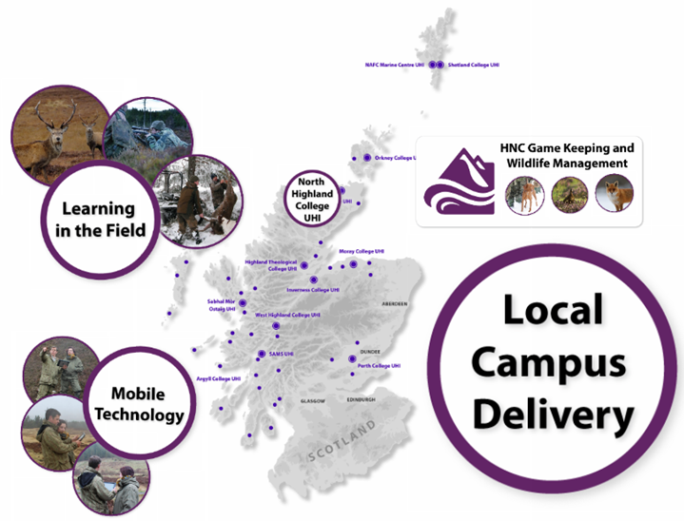

Slide 11
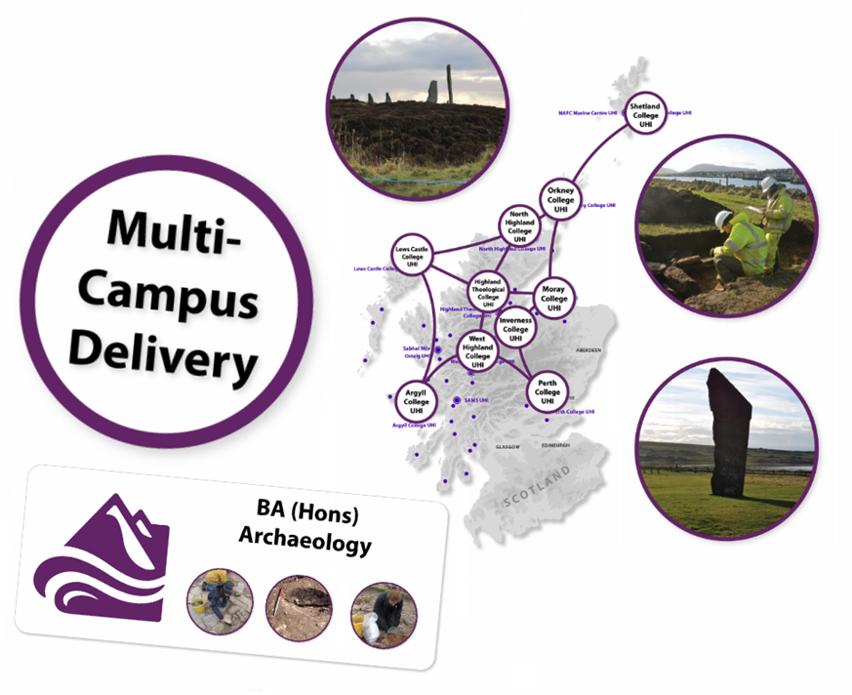

Slide 12
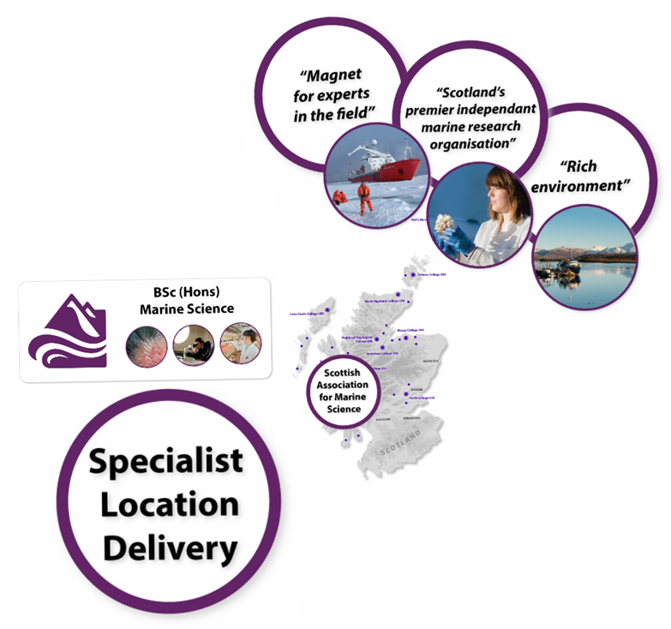

Slide 14
Rationale
UHID
Three original reasons
SFC independent income generation
Develop practices for domestic delivery
Enhance our sectorial reputation
Emerging reason
Market and network for other programmes

Slide 15
Geography
UHID
Two year Scottish honours programme delivered in England.
Online with local support
Based on principles of social constructivism
Three semesters
Non-SFC funding
Employability built in

Slide 16
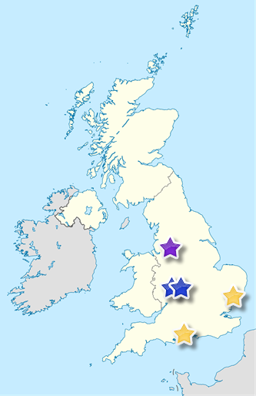
UHI Direct network
UHID
Hopwood Hall College signed for 2015/16
2 Solihull Colleges applying to host in 2015/16
Ipswich and Southampton Colleges in discussion for 2015/16
United Kingdom location map by NordNordWest CC BY-SA

Slide 17
Near future
UHID
Develop a network of 8-10 colleges
Deliver in region
More programmes: BACYS, Applied Science?
Six figure contribution by 2016/17
Direct access to English market FE and HE

Slide 18
LTA
EDU
UHID
Evolution: How, not what
Increasingly:
Transparent
Accountable
Integrated
Outward facing
Forward looking

