Slide 1
Educational Development Unit
FLUID Visit
Jacky MacMillan, Head of EDU
26th September 2014

Slide 2
Session objectives….
Introductions
The EDU Aims
Funding sources
Project Approvals Process
Engagement and Staff Development

Slide 3
Key aims of the EDU
To enhance the student experience through the increased use of blended learning.
To enhance areas of the curriculum by developing new blended learning teaching resources in collaboration with relevant stakeholders.
To develop staff in the delivery and modification of the new blended learning teaching resources.
To increase employer satisfaction with the skills of UHI graduates by engaging them in the curriculum development process.
Notes:
Linked to our vision and developed by the team at the start of the EDU in 2011.
Adhered to since then and used to measure our impact against.

Slide 4
EDU: Where we are now ….
24 curriculum development projects
380 members of staff engaged
30 plus training / dissemination events each year
~ 300 employers engaged with development
~ 300 resources available
Minimum of 50 resources under development at any one time
Notes:
24 Curriculum dev projects – ie 24 of the university’s programme teams since we began.
Engineering x 4, CPD Business, Creative Industries
Accommodation Management, Gamekeeping, Applied Music, Archaeology, Science in Industry, HN Events
Dental Technology, EECC, Geosciences, Strategic Leadership and Management,
Agriculture, BSc Applied Science, Care and Admin Practice
Geography, Induction, MSc Offshore Surveying, Sociology & Politics,
Schools Regional Project
Check number of available resources and those under development

Slide 5
Our funding sources
EDU budget
ESF
MSc Surveying
ESF
Faculty Projects
APs
Curriculum Development Fund
UHI Geography
HIE, STEM
Commercial
Notes:
Consequence of funding steams is the accountability aspect, constantly reviewing our methodology via evaluation / re-evaluation.

Slide 6
Project Approvals Process

Slide 7
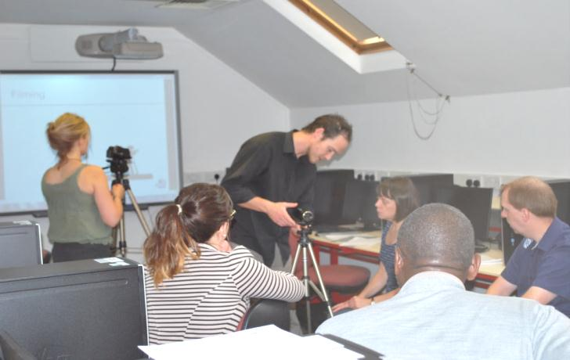
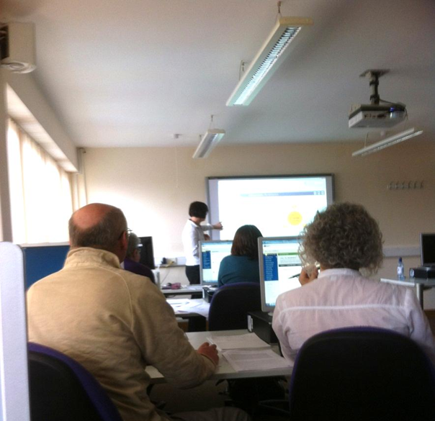
It’s more than just resource development …
Skills development for teaching staff
Skill Specific:
Creating video for online content at Moray College
Academic Partner:
“Skill boosters on your doorstep” at – West Highland College
Notes:
Hands on workshops to support staff using EDU resources or creating their own.
This picture was from an event at Moray College last year 20 August 2013
Ceiling of 10 participants
All 9 had short video clips to use in their teaching material.

Slide 8
A typical EDU project ….
Resource Development
Staff Development
Engagement
Dissemination
Project
Management

Slide 9
Pedagogy: quality and standards

Slide 10
Project team structure
Head of EDU
Project Associates
EDU Support Team
Educational Development Leader
Academic Development Advisor
Teaching staff to be involved in the maintenance and delivery of new materials
Academic Skills Developer
Administration Officer
Resource Developers
Project Co-ordinator
Project Team
Project Owner

Slide 11
ADA’s have said …..

Slide 12
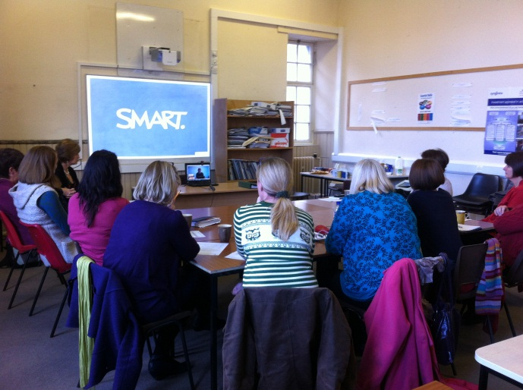
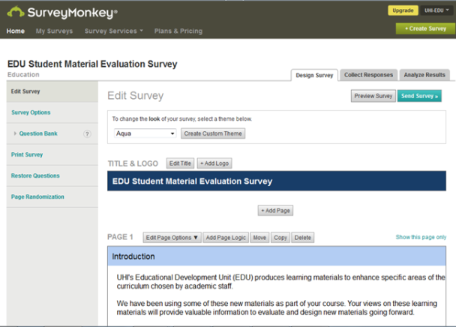
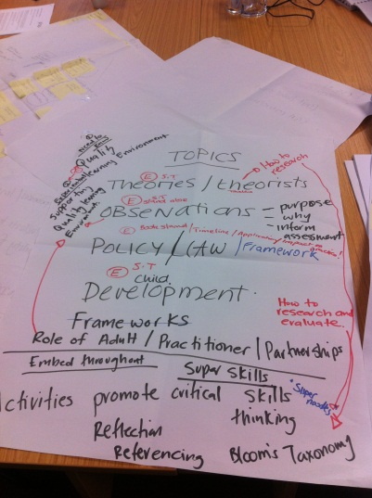
Early Education & Childcare Project
Project completion & handover
Peer review, feedback
Employer engagement
Project launch

Slide 13
EDU 2014/5
Resource development
Staff development
Signposting/ Advice
Online development
Employer engagement
Project Management

Slide 14
EDU Contact …
EDU Showcase
www.uhi.ac.uk/edu
edu@uhi.ac.uk
www.toolkit.uhi.ac.uk
EDU Projects on Blackboard

