Slide 1
The world’s largest media has no content, the world’s largest hotel has no rooms, and the world’s largest transportation company has no vehicles ....... how will the world’s educational institutions look in the future? Will they have classrooms? Will they have teachers? (SingularityU Copenhagen)
Hvad handler Learning Analytics om?
Big Data og Adaptiv Læring
Helle Rootzen - @hellehero
Professor in Learning Technology and Digitalization and
Head of learnT DTU - Centre for Digital Learning Technology
DTU Compute

Slide 2
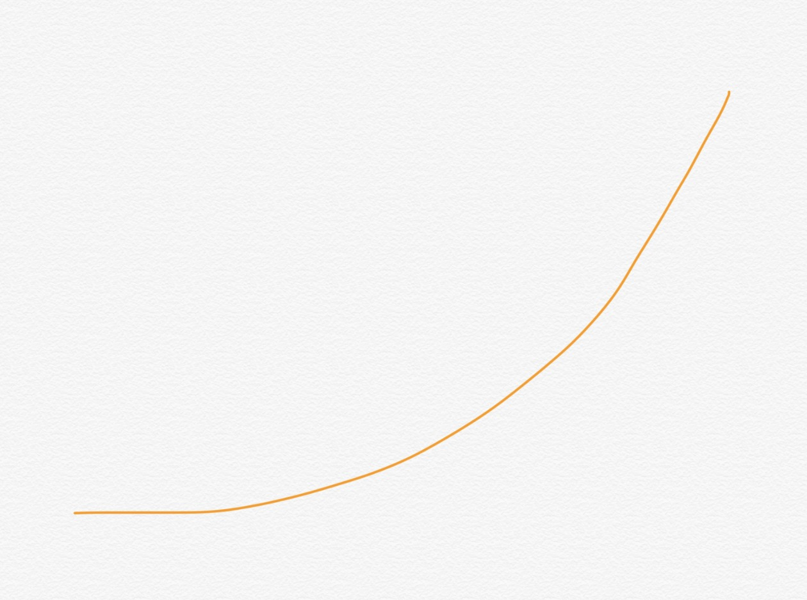

Slide 3
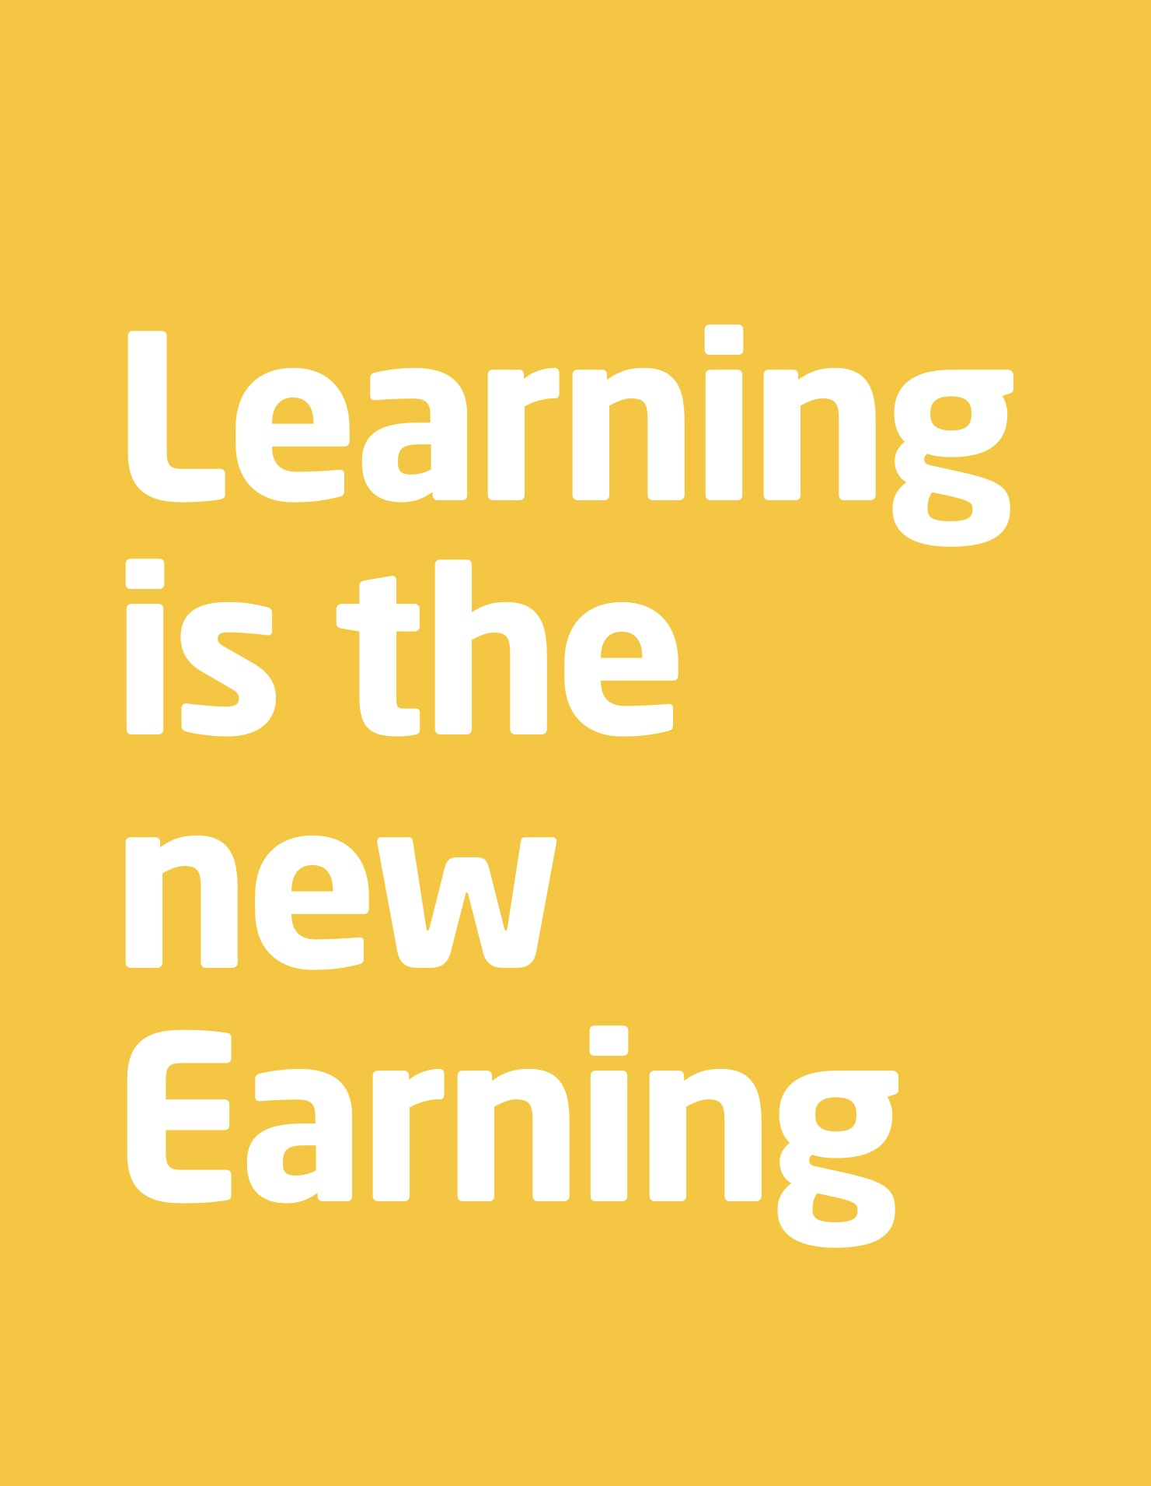

Slide 4
We live in the most exiting time ever .......
Everybody, from schools through universities to companies and organizations - need the right learning technology at the right time

Slide 5
Fremtidens digitale læringsteknologi -
nogle tendenser

Slide 7
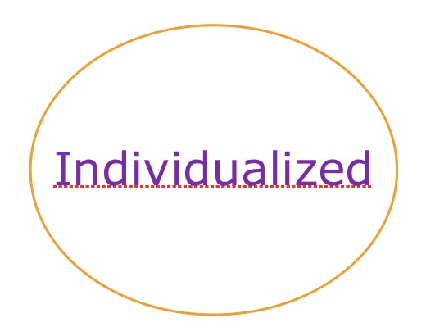
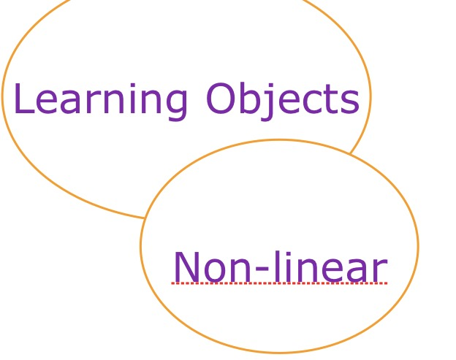

Slide 12
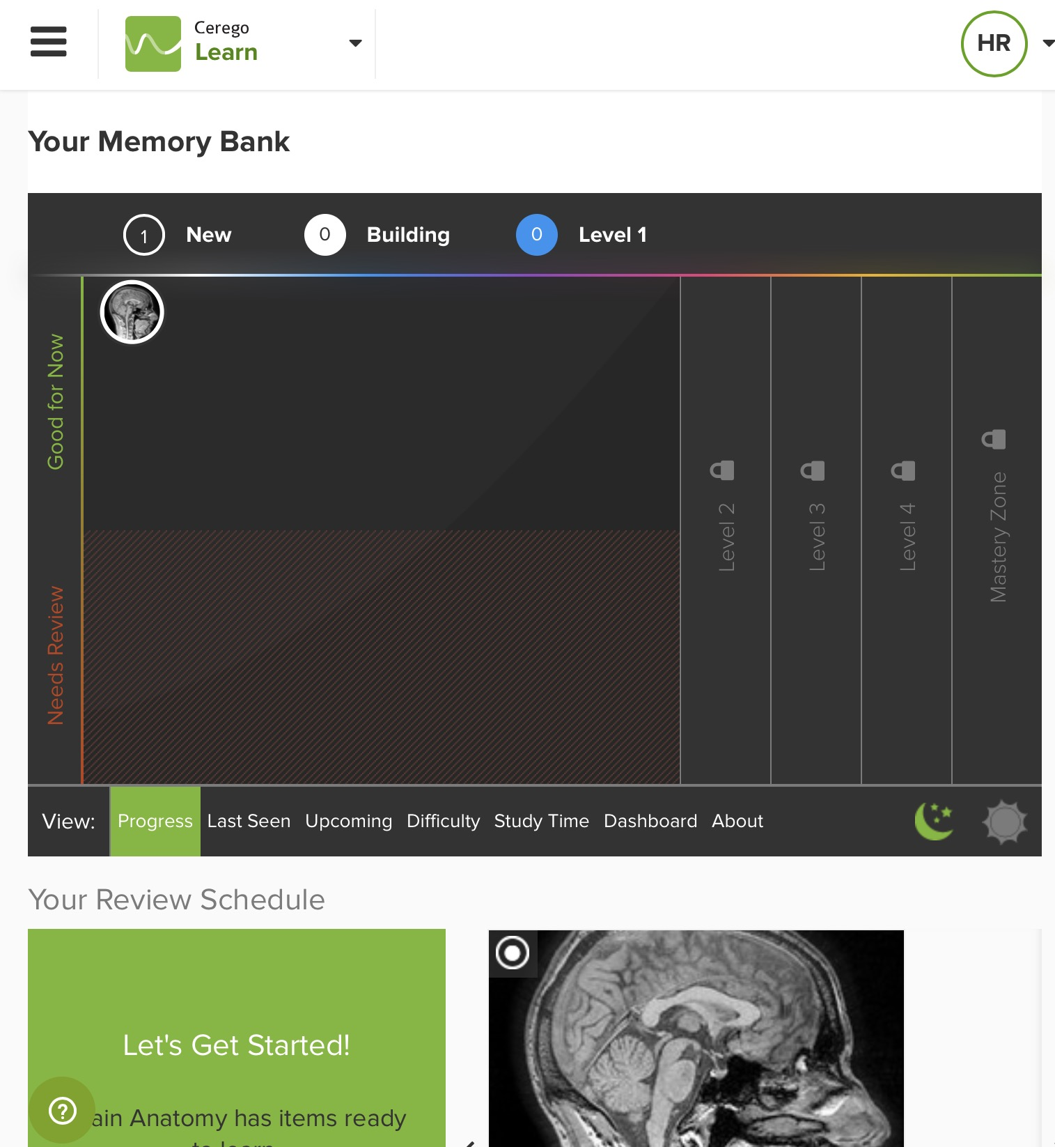

Slide 13
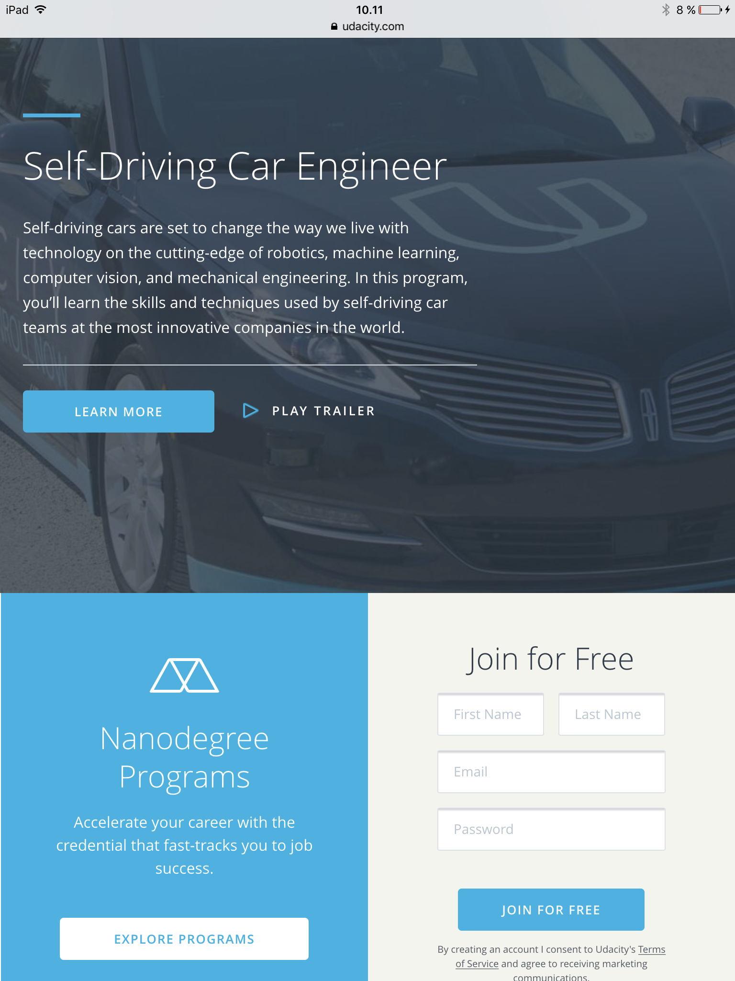

Slide 16
LA og EDM

Slide 17
Learning Analytics
Learning analytics is the measurement, collection, analysis and reporting of data about learners and their contexts, for purposes of understanding and optimizing learning and the environments in which it occurs. A related field is educational data mining.
https://en.m.wikipedia.org/wiki/Learning_analytics

Slide 18
Educational Data Mining
Educational data mining describes a research field concerned with the application of data mining, machine learning and statistics to information generated from educational settings (e.g., universities and intelligent tutoring systems).
https://en.m.wikipedia.org/wiki/Educational_data_mining

Slide 19
Formål med data
Validere et stykke læringsteknologi, en undervisningsmetode, ...... Evidens, kvantitativ/kvalitativ
Give information til elever, lærere, skole, kommune, ministerium, virksomhed
Forbedre et stykke læringsteknologi, en undervisningsmetode
Eksperimentere med et stykke læringsteknologi, en undervisningsmetode

Slide 20
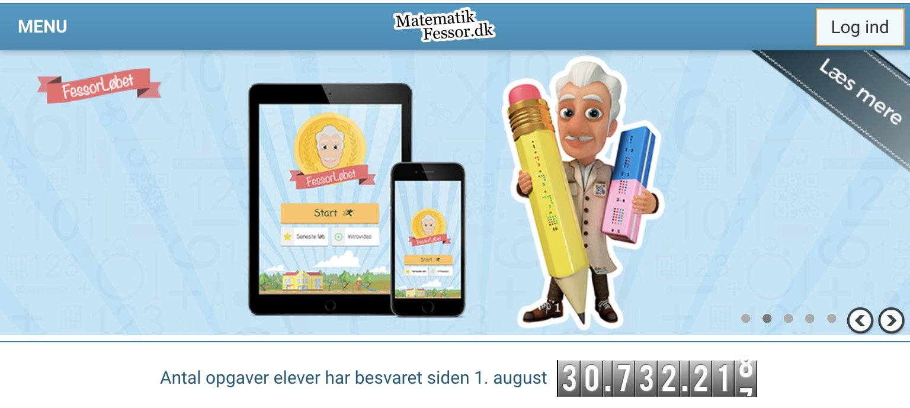

Slide 21
Big data in Learning

Slide 24
Combine Technology and people
Dare technology
Invite new players
Learning everywhere

Slide 25
