Slide 1
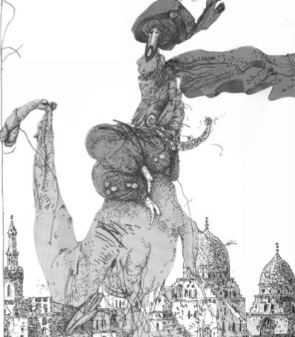
EDUCATION 4.0
Hans Jørgen Knudsen og Niels Henrik Helms
Niels Henrik Helms
Det Lærerfaglige Fakultet / Institut for Didaktik og Digitalisering / NCE
Notes:
Hedder det e-læring (korrekt) eller elæring eller? Sproget dk: http://sproget.dk/raad-og-regler/artikler-mv/svarbase/SV00001183

Slide 2
Content
Me
Generations
Learning Design Issues
Tribal War
Outcome
The Teacher

Slide 3
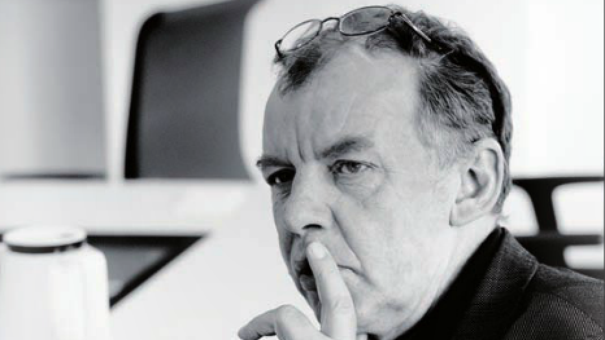
Working with learning, , Innovation and Media since 1980’ies. Docent at The Danish Institute for Educational Training of Vocational
Teachers. Associate Professor at University of Southern Denmark, Director, Knowledge Lab(SDU). Head of Research, Docent, University College Zealand. Independent Researcher and Consultant - Vidensemergens APS.R&D UX, Learning and Innovation.

Slide 4
Industry 4.0
Industry 1.0: (1784) : Based on mechanical production equipment driven by water and steam power.
Industry 2.0: (1870): Based on mass production enabled by the division of labor and the use of electrical energy.
Industry 3.0 (1969): Based on the use of electronics and IT to further automate production.
Industry 4.0 (today): Based on the use of cyber-physical systems.

Slide 5
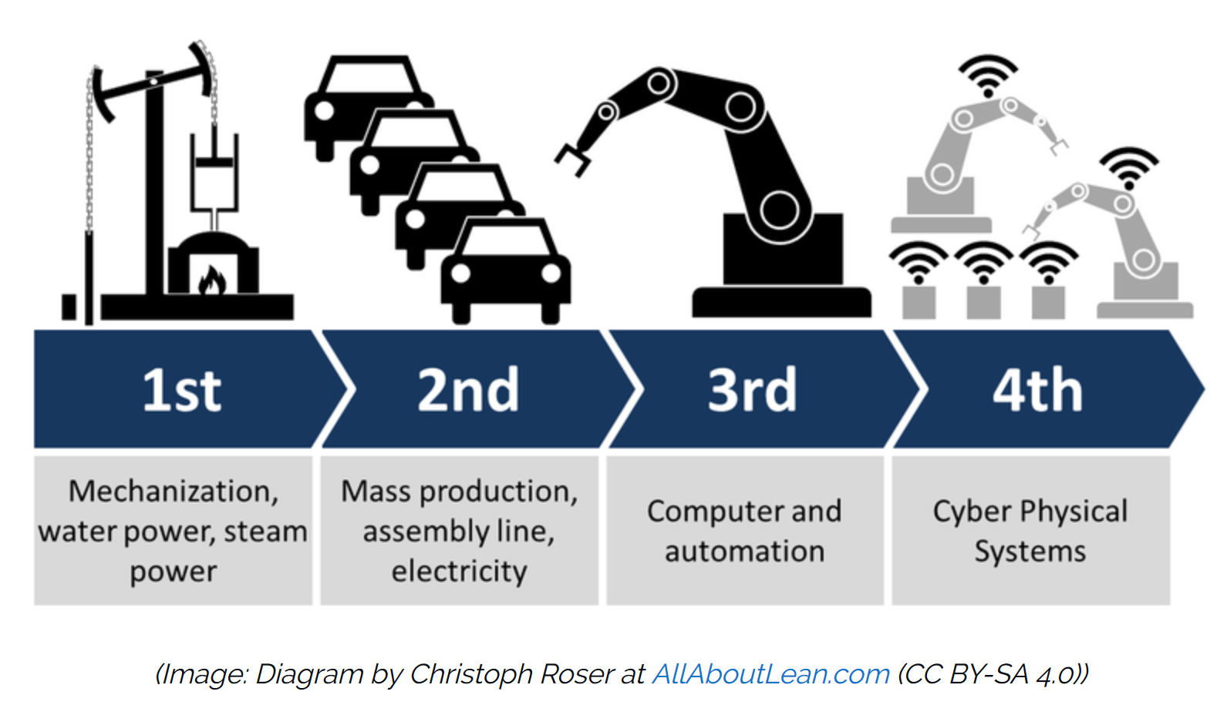

Slide 6
Education 4.0
Education 1.0: Memorization and merit-based differentiation (Formal Qualifications)
Education 2.0: Memorization and application (knowledge Reproduction) Mass Schooling – Mobilizing and including the masses to and in the Great Society (Qualifications)
Education 3.0: Technology (Oversold and Underused & Producing Knowledge) (Competence)
Education 4.0: Individualization – Inclusion by Difference – Innovation through Constellations – Discrete Technology – Micro Learning – Blurred Borders -Innovation

Slide 7
Definitions – The Phenomenon formerly known as:
E-learning - is the planned 1)acquisition, 2)sharing and 3)development of knowledge which is mediated or partly mediated through digital media

Slide 8
Understanding
That learning takes place
– transforming learning space to learning place
coupling with the learning environment –
Coupling with the learner
Notes:
Verb and noun

Slide 9
Presence
The learner is coupling to the learning environment/context. It is probably better to talk about coupling instead of embedding – it is a more dynamic description
It is a reciprocal process – continuous, reciprocal causation
The experience of being coupled to the learning environment should be labeled “Presence” - Flow
Presence is generated through the process of coupling and be scaffolded by cognitive and affective factors
No coupling – No learning

Slide 10

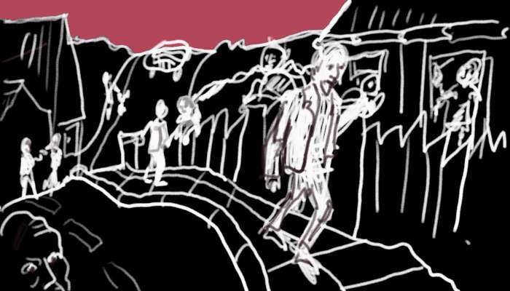
Learning Landscape
The learning landscape…it is a design
which affords a sudden interplay
or context..which again potentially
generates a re-configuration of the
learning landscape

Slide 11
Learning Design
Therefore we need learning design
The process of learning design refers to the activity of designing units of learning, learning activities or learning environment.
How do we then do that?

Slide 12
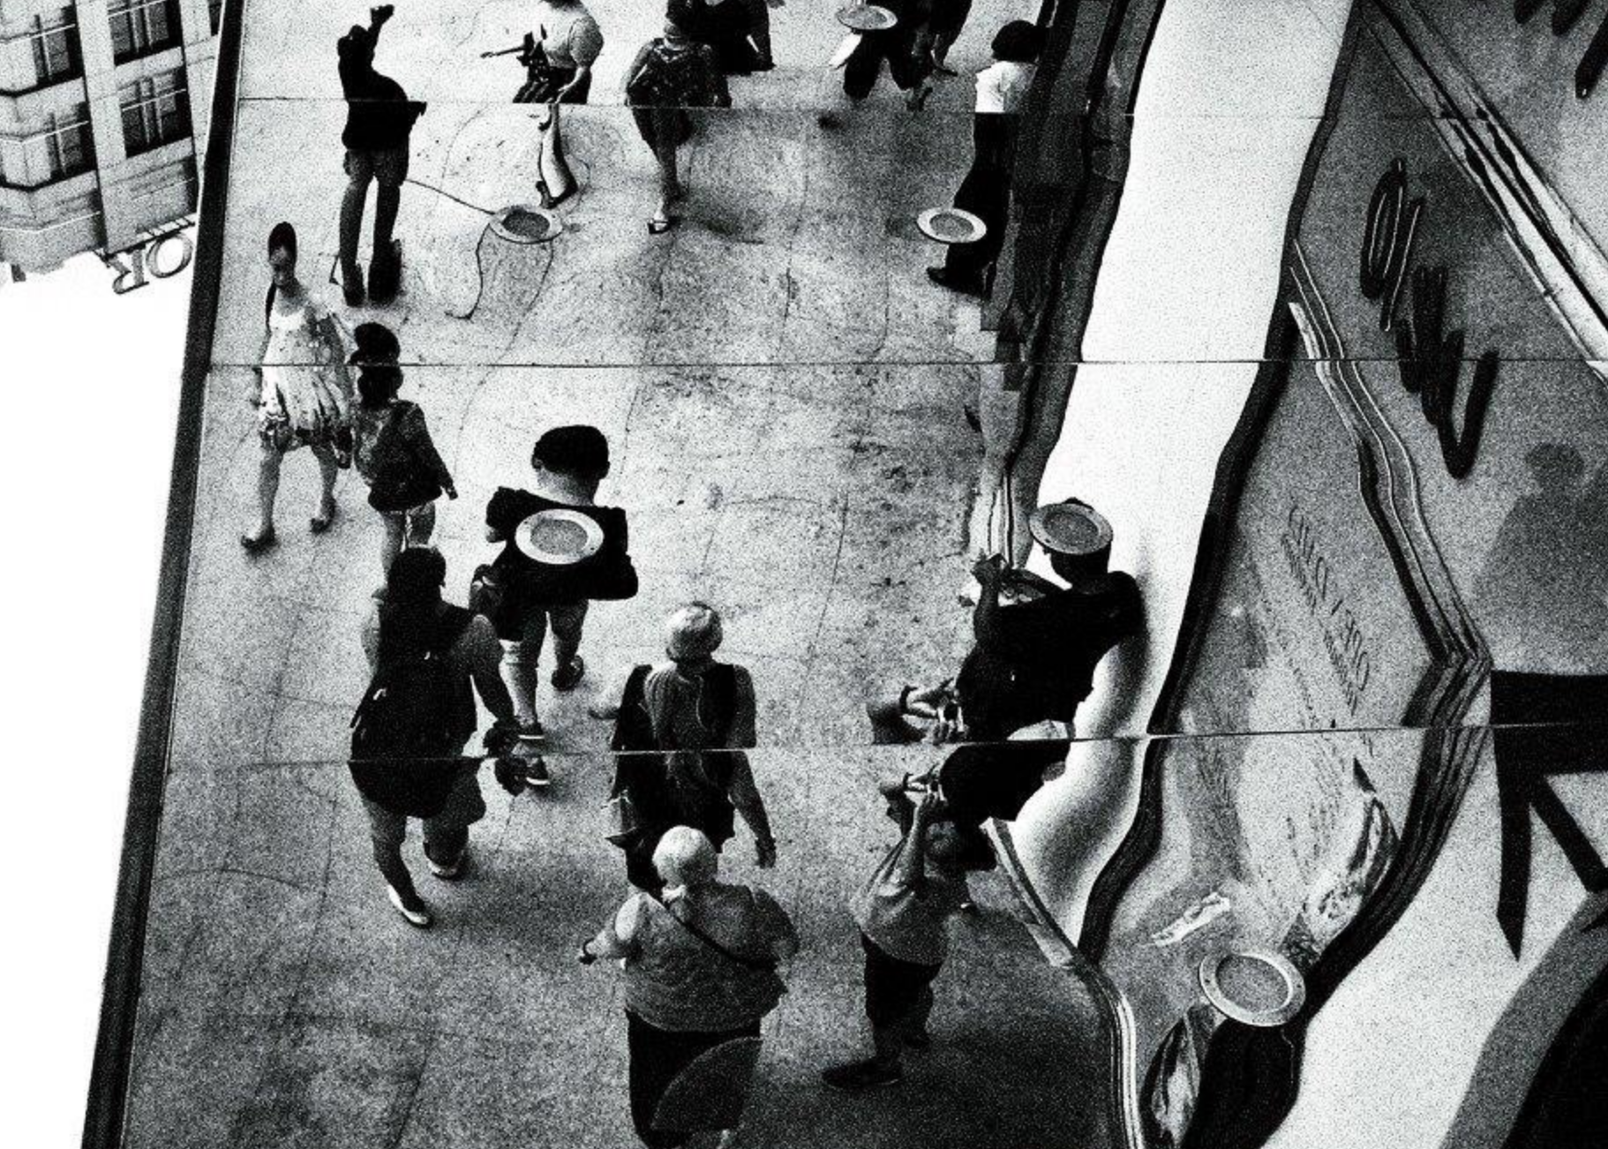
Follow the Learner???

Slide 13
And follow the Curriculum

Slide 14
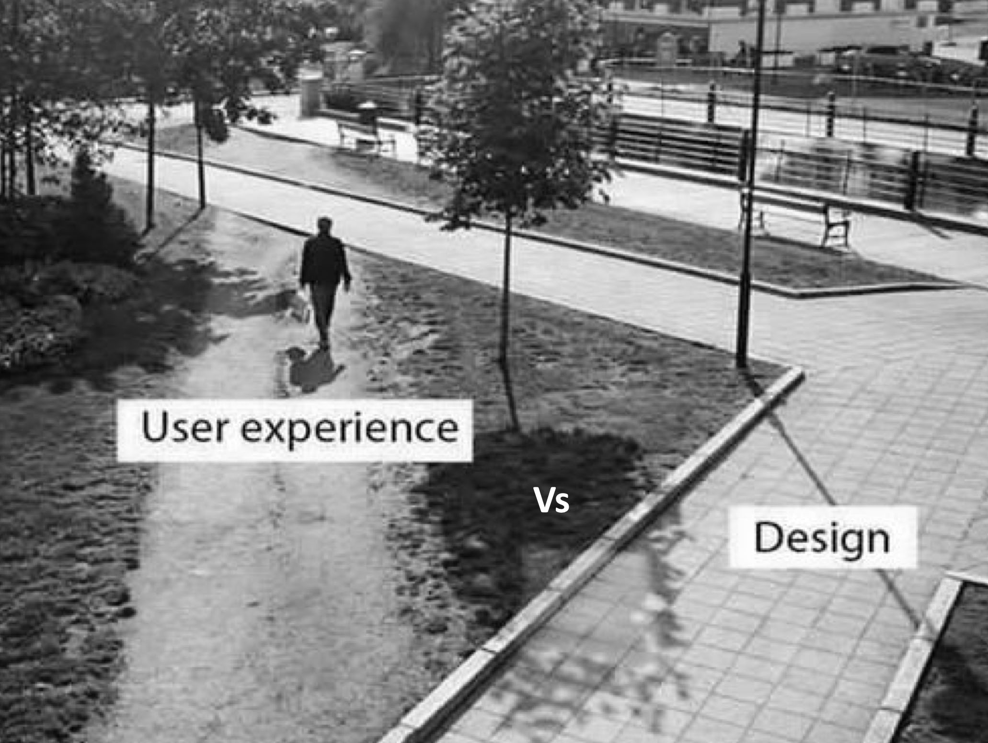
Designed Learning Paths vs Learning Trajectories

Slide 15
Follow the Learner??
Big Data
Patterns
Behaviour
Feed-Back
Feed-Forward
The Adaptive Challenge – the Potentials..

Slide 16
The Challenge of Education and of Learning Design
  The Intention – Education
  Framing for interaction
  Form for formatting for transcending the format
  The learner should meet the unknown, the unexpected – in a scaffolded way
  Learning environments should invite into estrangement
Become like the Others or get a Future

Slide 17
Address the tensions and potentials between
The Institutional Design
The Individual Design
ADAPT | INVITE
CHALLENGE | EXCLUDE

Slide 18
Past, Present and Future
If you want to develop digital infrastructures/content you should try to understand the context it should operate in (the present and the past) – and the future it should enable...
Digital artefacts reconstitute context – context reconstitute artefacts
We know that, governments know that, still we seem to forget it...

Slide 19
Adaptive Educational Designs
Access to education (educational ressources) independent of time and space
Identification and recognition of prior learning
Adaptivity - moduarlization in relation to learning needs
Different pedagogical designs – Cultural Coding

Slide 20
Dynamic Adaption
The reciprocial interaction between environment and actor
Opening/declaring a break
Drawing a Distinction
Grounding the Distinction
Embodying the Distinction
Learning is the embodyment of knowledge
Learning is the de-embodyment of expirience

Slide 21
Transcending the Tribal War
Instructional Design + Performance Technology + Ideology (Behaviorism/Cognitivism)
Heuristic Design + Biographic Technologies + Ideology (Connectivism)

Slide 22
The Kind of Education we Need? The Kind of Learning Environments???
Should they be a kind of incubators and simulations of the life and work life learners should participate in?
Or should they offer the potentials of a different context, which offers a culture of friendly estrangement where learners have the potentials of knowing about themselves and the world they are part of by creating the difference, which make reflection and insight possible.

Slide 23
”YES!!”

Slide 24
The School, is a School is a School
Making distinctions to other contexts
(Pupil)”Elev” – A process of elevation
Participant, participation – degree -level, quality?
Learner – Learning? Re-learning? New-Learning? Self construction
The Learning Evirionment/ The Learning Context

Slide 25
Different Learning Contexts
Different areas and forms of practice
Make rules, values & criteria for evaluation explicit
Context markers
Make the context readable

Slide 26
The Outcome
Learning is not mathematics where the outcome /the result is equal to input and conditions
It should rather be seen as an understandable configuration of relations where we through a narrative structure generates meaning and understanding
This understanding also shows that it is our self who constructs order through action and reflection -

Slide 27
The Teacher
Curator – Selecting, validating, making openings.
Narrator – Enabling narrative structures, paths for learning.
Champion – Leading, standing in front
Scaffolder – Standing behind, supporting

Slide 28
Competence/Organisation
 | Competence | Organisation
Before | The Same | Apart
Now | Different | Together
T-Competence
Creating Constellations

Slide 29
Q & A, nihh@kp.dk

