Slide 1
how to support local and regional Development
4. juni 2019
By director Kresten Olesen, REG LAB

Slide 2

REG LAB – in short
  History: association since 2009.
  Mission: Not-for-profit independent ’laboratory’ - developing new knowledge on regional economic development.
  Funding: 100% funded by members. More than 100 members.
  Board: 16 executives in state, regions, municipalities, knowledge institutions and organisations.

Slide 3
Why is it relevant?
Workplaces and tax do not happen by themselves. 800,000 job openings a year in Denmark
Businesses have become more mobile and competition has become tougher
If this does not succeed, one loses the competition, and then the result is a declining tax base, declining settlement and thus lower welfare.
Active regional and local development and business policy is no longer just a nice to have, it is need to have
So the task is to attract people and attract companies and provide the necessary framework conditions – those are in many case related
Notes:
Den globale konkurrence
Arbejdskraft den største udfordring
Kærlighed, job og uddannelse
Vækst i hele Danmark

Slide 4
It's not just about graduates

Slide 5
The Public agenda :
More Jobs
Companies’ agenda:
More value with fewer workers
Notes:
Den traditionelle målsætning er flere jobs. Den selvforståelse giver ikke fyldestgørende mening.
Virksomhederne er interesserede i at få den bedst egnede til at løse opgaven – ikke vækst

Slide 6
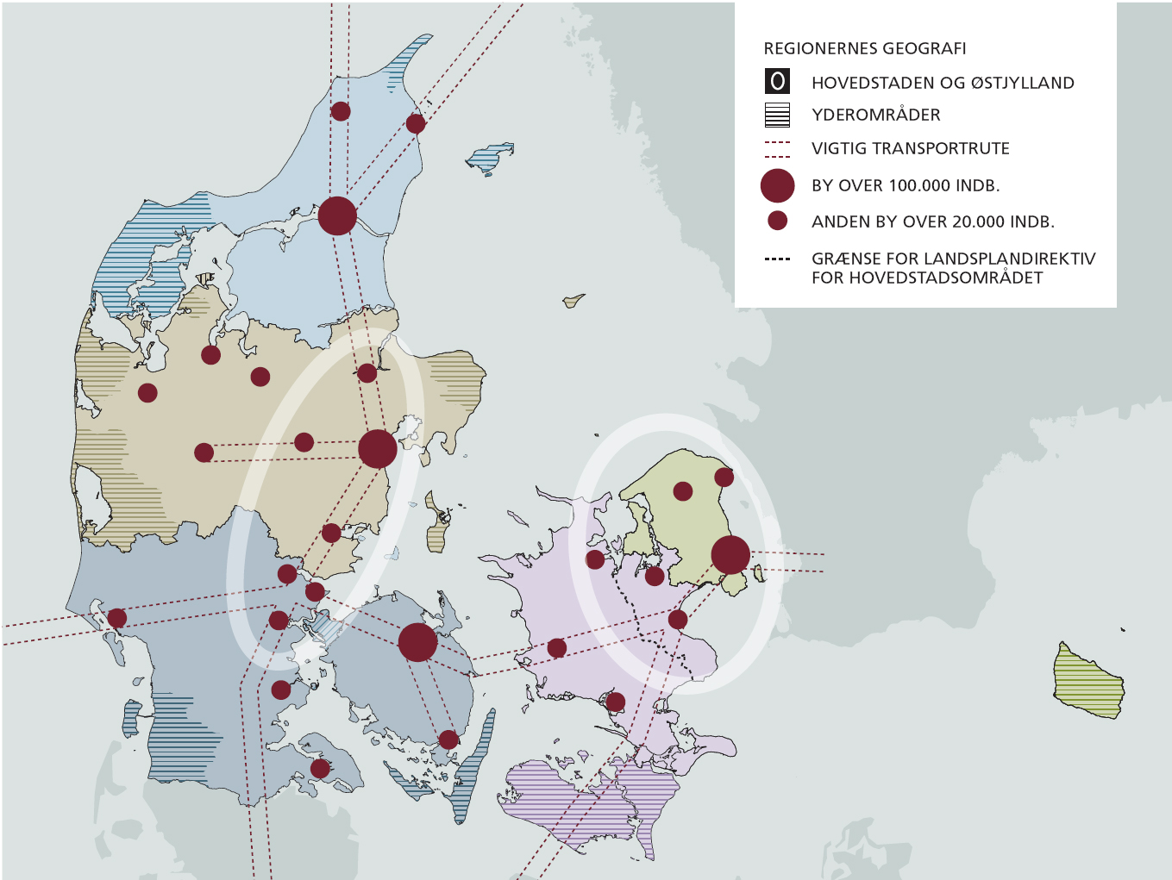
Denmark: Citysystems
Metropol
Regionalt center
Andre byer > 20.000 indb.
Vækstregioner: landsplanen
Udkantsområder
Transportkorridor
Notes:
Husk norge og sammenhængen mellem infrastruktur og erhvervsudvikling/bosætning. Effekten kommer kun i kombinationen
Digital infrastruktur

Slide 7
What makes people move
Notes:
Work- husbon/vife and there jobs, school, next job – karrierer
Education make area growth, how to make people aty after education
Knowledge institutions also have til work together with there surrounding (companies etc,)

Slide 8
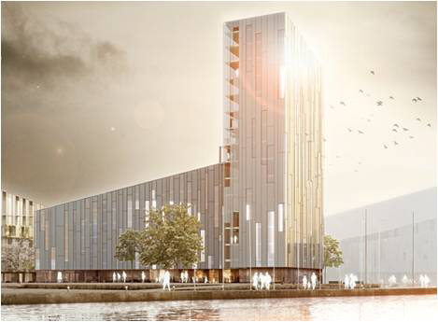


Ålborg
Henning Larsen- student housing at the harper front!
Aalborg have a vision to be the best educational city in Denmark
Private and public cooperation to create attractive urban spaces. It is about leadership and joint mobilization
Notes:
Student housing in the most attraktive places in Ålborg
Coorporation with university and private companies on secure jobs
Husk Horsens

Slide 9
Municipality 3.0
1.0 A municipality is an authority that makes decisions based on legislation and administrative practice
2.0 The municipality becomes a service organization that offers a lot of services
3.0 A municipality is a community of actors, citizens, associations, organizations, companies, etc. that come together in order to solve specific issues of importance for society. The municipality becomes more and more a matchmaker
Create a growth culture
Notes:
Have visioner – hvilke aktører/ildsjæle kan spille med
Horsens
tillid, støtte op om ildsjæle inddrage ressourcepersoner,

Slide 10

Stedets energi
Notes:
Vi handler vi sidder ikke bag murerne. Vi går forrest

Slide 11
qualified labour

Slide 12
Main conclusions
There is a lack of labor throughout the country. NOW - and even more in the years to come
Many companies are challenged. many take action proactively. some of them succeed
The companies' competence supply shall be linked closer to the business model
Notes:
Tiltrække arbejdskraft handler om mange ting, medrejsende, næste job, kultur og liv
Kalundborg

Slide 13
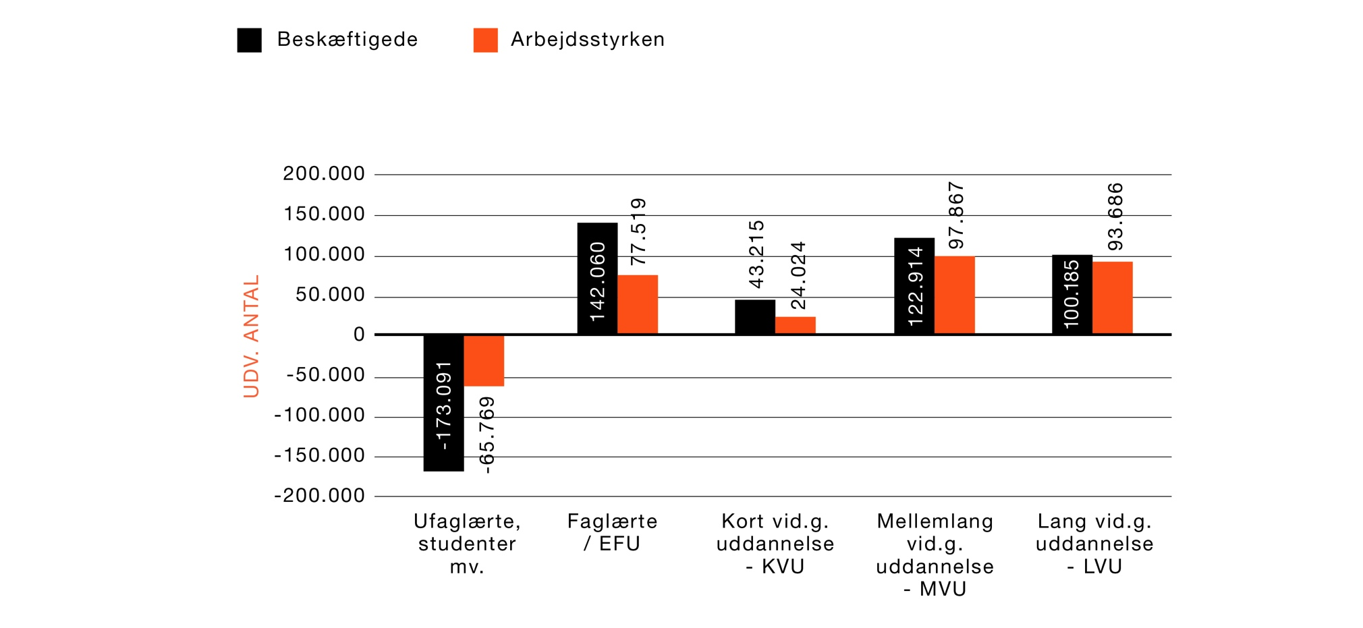
Ændring i beskæftigede og arbejdsstyrken 2013 til 2023

Slide 14
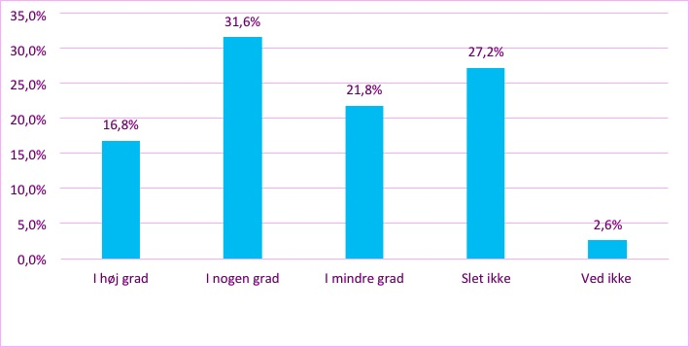
50 % of the companies have had challenges in recruiting labor
Notes:
Samle virksomheder, specialisering, svært med en virksomhed og udd.

Slide 15

companies competence supply in the future
Greater overview and more long-term planning
Connects competence supply with strategy and business model
New recruit patterns
Increased digitization, reorganization and outsourcing
Broader recruitment and increased internal development/education
Take greater responsibility for providing qualified labor
Notes:
Marcod
STØRRE OVERBLIK OG MERE LANGSIGTET PLANLÆGNING:
Virksomhederne arbejder systematisk og langsigtet med kompetence- forsyning; fra år til år frem for fra måned til måned.
Har koblet kompetenceforsyningsindsatsen med virksomhedens strategi og forretningsmodel. Med andre ord placeres kompetenceforsyning i hjertet af virksomhedens strategiske udviklingsplaner.
NYE SØGEMØNSTRE: Virksomhederne agerer aktivt og målrettet i relevante delarbejdsmarkeder; de søger uden for regionen og internationalt, når det er nødvendigt.
ØGET DIGITALISERING, OMORGANISERING OG OUTSOURCING: Nye teknologier og forretningsmodeller åbner op for, at virksomhederne kan regulere deres kompetencebehov mere fleksibelt; fra ordre til ordre vælges den mest optimale kompetencemodel.
BREDERE REKRUTTERING OG ØGET INTERN UDVIKLING:
Virksomhederne udvider deres søgekriterier; de bruger mere tid og flere ressourcer på at få medarbejdere godt ombord.
STØRRE ANSVAR: Virksomhederne tager selv et større ansvar for at fremskaffe kvalificeret arbejdskraft ved at skabe akademier, uddannelses- netværk samt tiltrækningskampagner i netværk, klynger, brancher og sammen med de offentlige aktører.

Slide 16
Digital transformation of SME´s

Slide 17

Notes:
Disruption mv. vi skal ikke overdrive

Slide 18

The digital transformation
Digitization takes place step by step
The barriers are relatively limited in the first stages of digitization - once the companies have started.
The final steps are difficult. The complexity and challenges increase as the companies move up the digital staircase.
Few SMEs have really started digital innovation and business model and few are using the capabilities of IoT, AI, machine learning, big data etc.
Notes:
Note: Modellen illustrerer på den ene side de forskellige trin i digitaliseringsprocessen, og på den anden side viser figuren, at virksomheders digitaliseringsrejse både kan gå mod højere effektivisering (X-aksen) og mod merværdiskabelse som f.eks. nye eller forbedrede services og produkter (Y-aksen). Inden for hvert trin kan virksomhederne bevæge sig mod en større eller mindre grad af effektivisering, ligesom der kan være forskel på, hvor stor merværdi digitalisering skaber. Analysen viser en tendens til, at procesoptimering oftest er den primære motivation for digitalisering på de tre første trin, mens merværdiskabelse oftere er en driver for virksomheder på de øverste trin. Generelt vil det dog typisk være sådan, at både graden af merværdiskabelse og effektiviseringsgevinsterne øges, når virksomheden bevæger sig opad på digitaliseringstrinene.
Analysen viser dog også, at digitalisering ikke nødvendigvis for alle virksomheder har samme endegyldige mål om at digitalisere selve forretningsmodellen. Der vil helt naturligt være forskel på, hvor langt op ad stigen virksomhederne i sidste ende kan og vil nå – og for nogle vil en decideret digital forretningsmodel slet ikke give mening. Blandt casevirksomhederne i analysen er der desuden også flere eksempler på virksomheder, der efter at have taget en række trin opad ’går tilbage’ ad trappen for at genbesøge og forbedre, hvad de eksempelvis har gjort i forhold til digitalisering på nogle af de første trin.

Slide 19

What characterizes the successful SME’s?
A pragmatic approach to digitization:
Standard solutions over large development projects
One step and one solution at a time - no overall digitization strategy to start with
Specifically problem-solving-oriented
Early digitization of core processes – it is really kick-start and not least enables the further digital transformation
And then they are successful at driving and managing change processes and involving of employees

Slide 20
Education - Knowledge bridges
Notes:
Hvilke kandidater har vi brug for. Folk flytter ofte på grund af uddannelse

Slide 21
Create a educated workforce
Education institutions is vital for Growth
New Candidates
But equal important are the capability to create knowledge bridges

Slide 22
Where do we stand
Knowledge collaboration is growing
Significant effects of knowledge collaboration - documented in several recent analyzes
Great potential for more companies to participate in knowledge collaboration
The share of innovative companies that cooperate with knowledge institutions

Slide 23
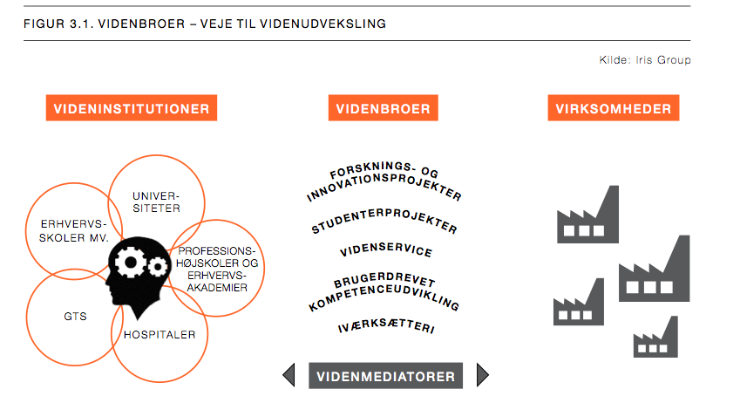
50 cases of succesSful collAbOration
Notes:
Hvilken viden, erhvervskoler, studenterprojekter

Slide 24
14 Steps for successful knowledge collaboration

Slide 25
Programs and projects
Reserve funds for activities in the "pre-phase"
Use a matchmaking function as an element in programs and projects
Increase the flexibility of the programs’
Require systematic follow-up and evaluation for each company in all projects
Create opportunities for ongoing facilitation throughout the project - especially important for large projects and SMEs without experience.
Strengthen the use of knowledge mediators - especially for SMEs

Slide 26

Thank you for your attention

