Slide 1
The blended equation…
Jesper Stensbo Knudsen
Technical University of Denmark

Slide 2
The blended equation: But where is the student,
the teacher, the learning?
Jesper Stensbo Knudsen
Technical University of Denmark

Slide 3
But where is the student?

Slide 4
User driven innovation – design based research
Research design
Who are the users
Change of content through change of design
The programme design
1
2
4
3
Reference: ELYK-project, 2012

Slide 5
From in-line | To online

Slide 6
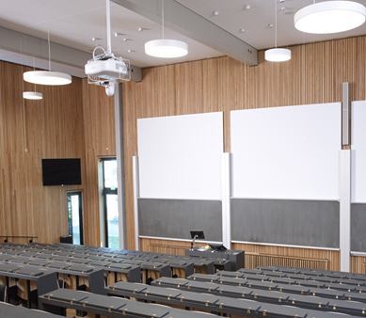
where is the teacher?
Setup suited for the individual teacher
Development of competences
Recruitment of teachers

Slide 7
….where is the learning?
Fear of distance
Fear of loosing control
Regaining intimacy
Student’s work embodies the teaching
Capture the contact
The teaching
Student feedback
- Teacher feedback

Slide 8
The scope of the project
Transformation: from development to organizational structure
More than project management
Rethinking the essential question of teaching: What is good teaching?
From development to organizational structure; a matter of culture, that is teaching philosphy….

Slide 9
THANK YOU!
Jesper Stensbo Knudsen
Technical University of Denmark
e-mail: jsk@adk.dtu.dk
Sources: all pictures gathered from Free pic, SDU, DTU

