Slide 1
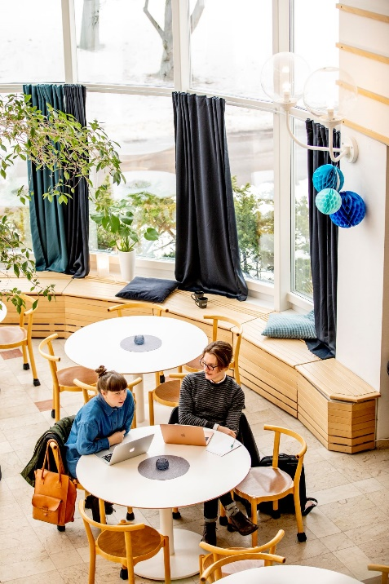
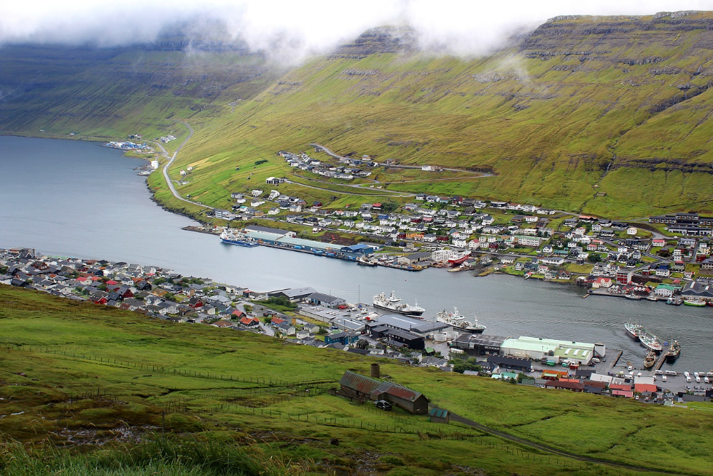
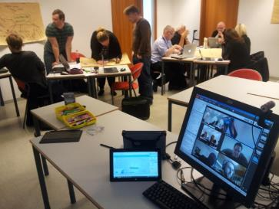
Presence at a distance Success factors for educational projects in rural areas

Slide 2
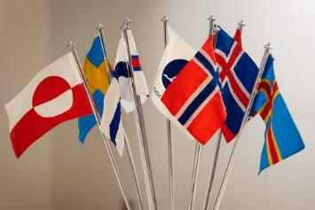
Presence at a Distance
Hróbjartur Árnason (University of Iceland, School of Education, Iceland) Alastair Creelman (Linnaeus University, Sweden) Carola Eklund (Government of Åland) Deirdre Hansen (University of Faroe Islands & Distance Learning Centre Fjarnám, Faroe Islands) Torhild Slaatto (ICDE, Norway)
Jørgen Grubbe (Foreningen for Fleksibel Uddannelse i Denmark)
Photo: CC BY-SA Some rights reserved by Ane Cecilie Blichfeldt on Wikimedia Commons

Slide 3
Presence at a Distance
Structure
Success factors for educational projects in rural areas?
Methods for analysis
Revisit projects from earlier studies
Analysis and interviews of successful and failed projects
Interviews with experienced project managers
Analysis of results
Recommendations
Photo: CC BY-SA Some rights reserved by Ane Cecilie Blichfeldt on Wikimedia Commons

Slide 4
Lifelong learning in rural areas
Key to economic development
Community development
Challenges
Matching competence development with job opportunities
Limited access to learning
Support for LLL
Enablers
ICT and distance education
Co-operation between authorities and local business

Slide 5
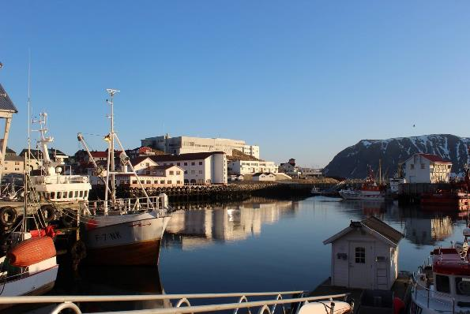
What are the success factors for educational projects in rural areas?
Why do some projects succeed?
Why do some projects not succeed?
Why do some projects take on a life of their own?

Slide 6
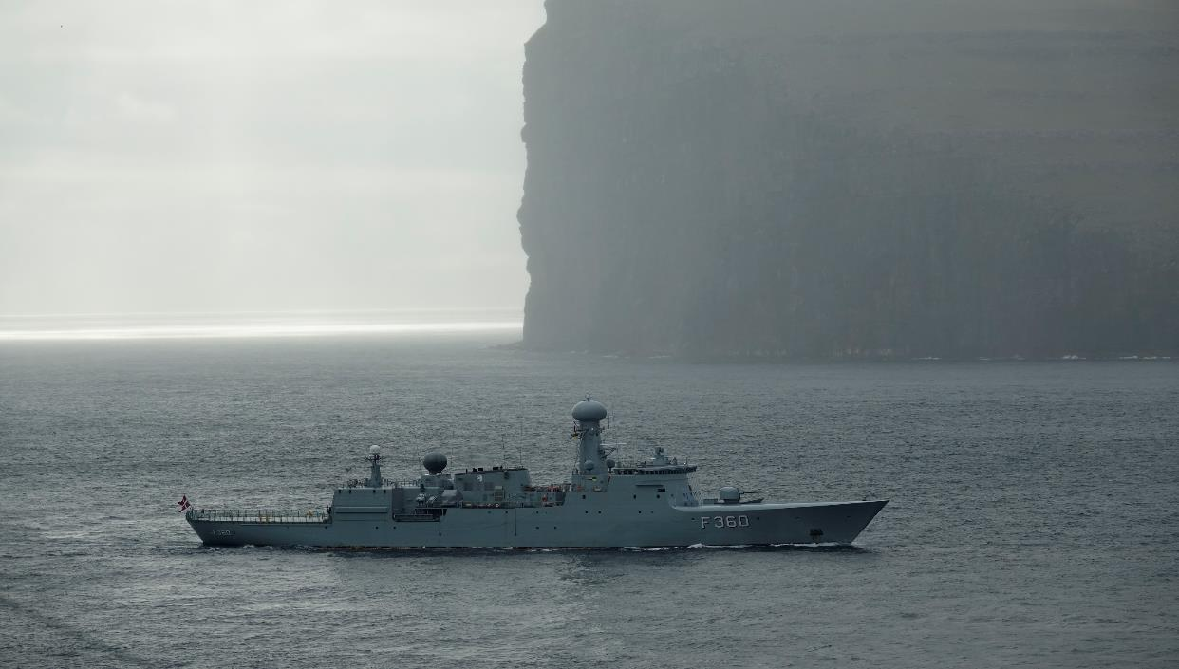
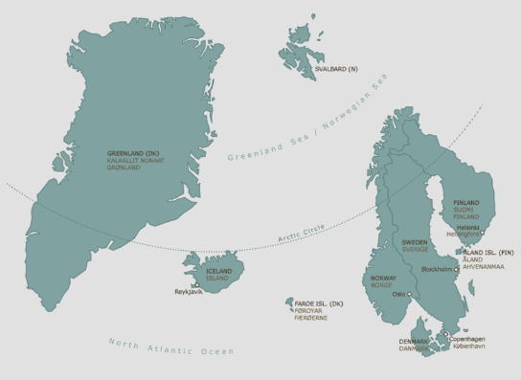
Føroyar The Faroe Islands - a selfgoverning region of the Danish Kingdom

Slide 7
Nordic Network for Adult Learning - NVL Distans Two cases from the Faroe Islands
Situated within the Nordic region
Specific features:
Needs as islands
Needs as small states
Growing autonomy
What can be learnt from the emerging new approaches to policy and practice in these areas?
Notes:
Example of Faroese ‘sheep cam’ – doing things differently / innovating in smaller communities.

Slide 8
Føroyar – sheep islands

Slide 9
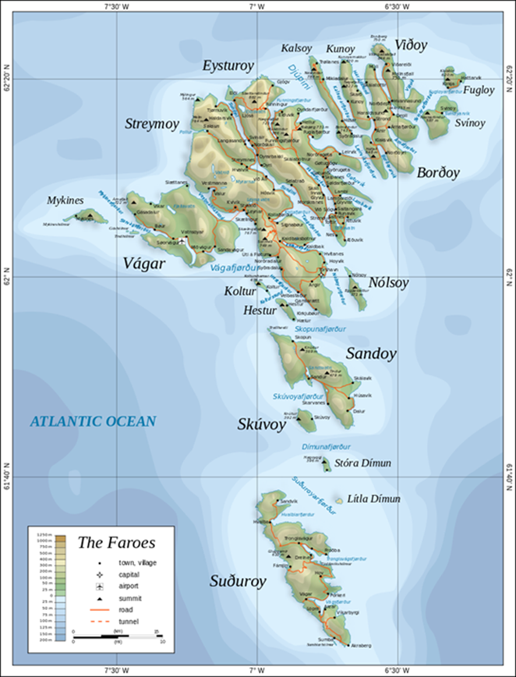
The Faroe Islands
Population: February 2019: 51,440
Size: 1,400 square kilometres
Official languages: Faroese (Danish is co-official)
Faroese: first language of the vast majority: 93,8% (Census 2011)
Recent demographics: increase in diversified in-migration
A highly multilingual society: 100+ languages identified as citizens’ first language (Census 2011)
‘A culture of migration’ (key feature)
Economy: largely reliant on the fishing industry (including aquaculture), accounts for 95% of exports
Education system: follows the Danish system. Faroese is the medium of instruction.

Slide 10
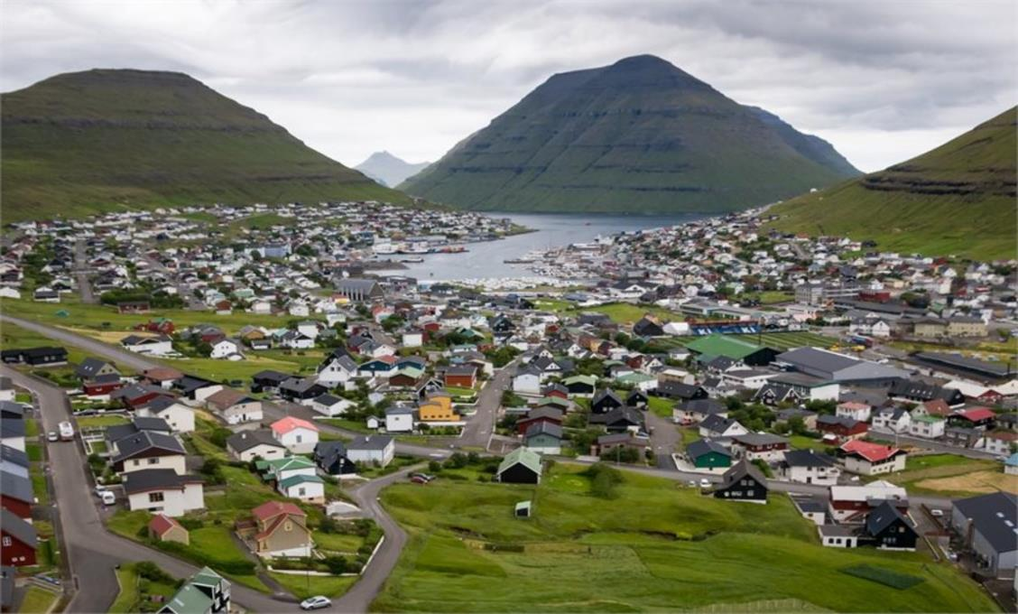
Case one
Klaksvík
N 62° 13' 30 V 6° 34' 50

Slide 11
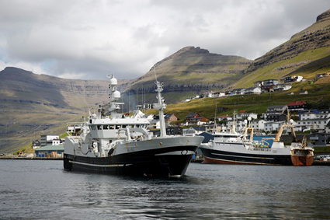
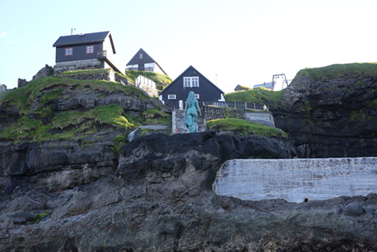
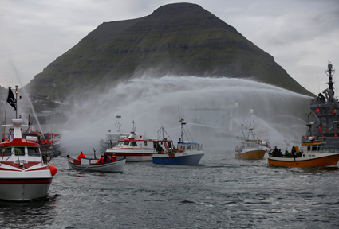
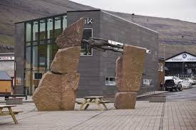

Slide 12
AIM: to offer adults LLL and LLG
FOCUS: create learning environment locally
PROGRAM: Offer Career Guidance and support Distant Learning students
CHALLENGES: New concept in small society
Klaksvík
2nd biggest town and municipality in the islands
5.000 inhabitants on 4 islands
Fishing industry is dominant
Obstacles in 2013:
Decrease in population
Brain Drain
Women left for better education and job opportunities
Solution:
Lifelong Learning & Lifelong Guidance???

Slide 13
To combine: House of innovation “Íverksetarahúsið” - Workspace for innovation and support of entrepreneurs & Distant learning centre, “Fjarnám” - offering Career Guidance and Counselling for Adults (the first of its kind outside off the educational system)
Opportunity arose in 2015:

Slide 14
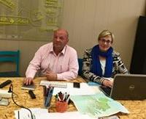
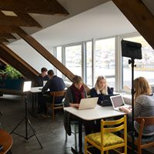
2019
Fjarnám
is the first
local platform
to combine and support:
Adult education
Career guidance and counselling
Collaboration between workplaces and studies
Innovation
Socialization
“Youth into work – UíA”

Slide 15
History of Guidance in the Faroese Community
Case two
In 1974 guidance in education started, as part of higher preparation courses, HF
The guidance community, in the Faroe Islands for many years wanted higher education for guidance counsellors
Vegleiðrafelagið 1989 – guidance union
through Nordic cooperation in counselling - got together with the University of Faroe Islands, the Ministry of Education and the University of Iceland, HI and Nordplus VALA
in 2013 the Faroese University offered a MA in Guidance

Slide 16
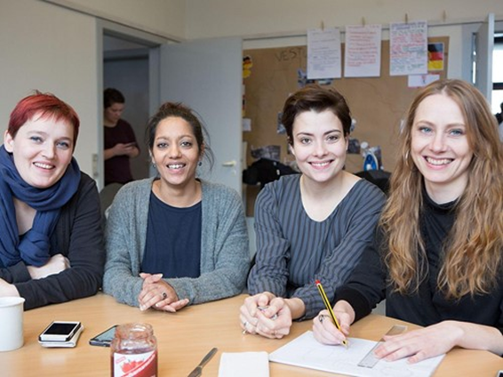
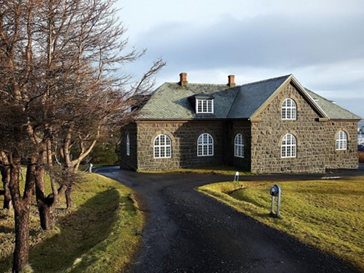
MA in CGC – Career Guidance and Counselling
Part time; blended & distance learning; taught by international experts
The aim is to
prepare students to provide CGC in an LLL perspective;
provide the foundation for the professionalization of the CGC services in the Faroe Islands;
develop services and local knowledge in the field
Outcome: LLG services for all citizens

Slide 17
Implementing Distance Learning
Educational context:
Danish models
Danish language
Higher education in some subjects
Labour Market context:
Small
Specialised (with a focus on sea-based industries) and therefore also:
Gendered
Prone to flux
Feels like being a waterfall in a storm ;)
Notes:
Educational context:
Danish models
Danish language
Higher education in some subjects
Labour Market context:
Small
Specialised (with a focus on sea-based industries) and therefore also:
Gendered
Prone to flux

Slide 18
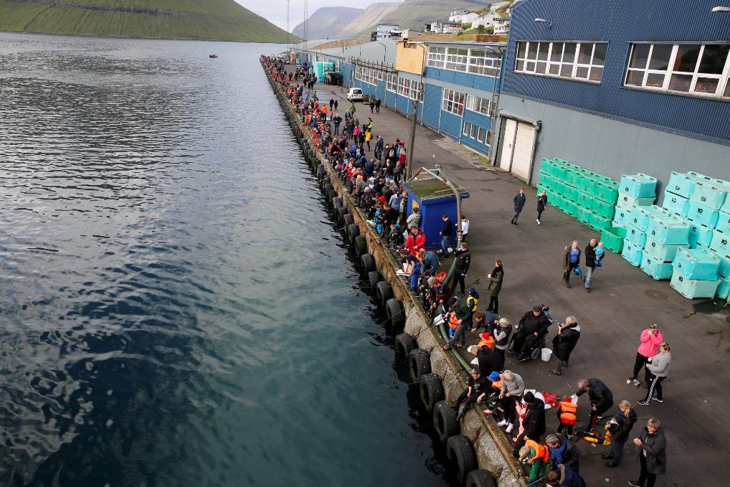
The two cases give hope for future generations

Slide 19
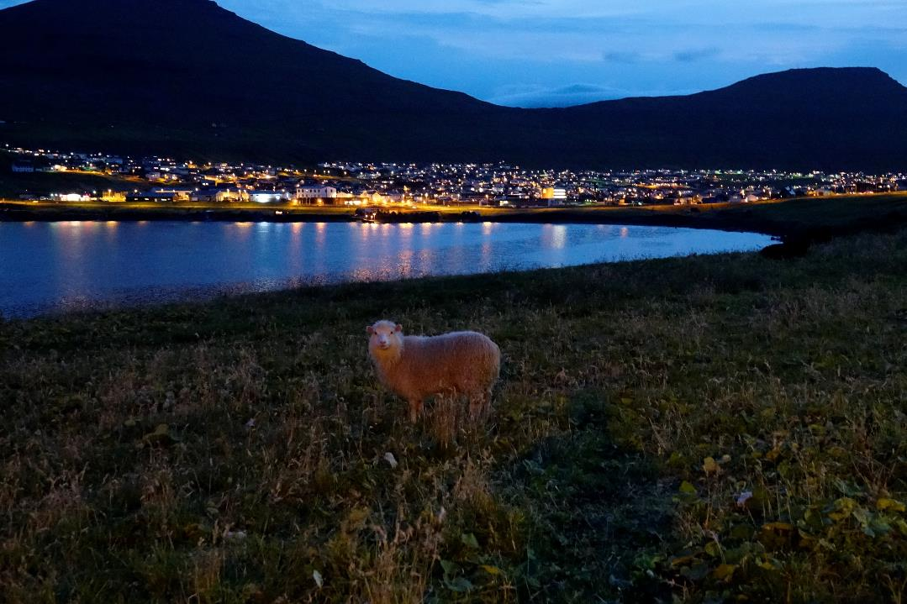
Deirdre Hansen Fróðskaparsetur Føroya
&
Fjarnám

Slide 20
THE TYNSET CASE
Challenges in rural areas: Matching competence development with job opportunities. Is there support for LLL?
The Tynset case:
The Norwegian National Health Archive opens 1 April 2019 in Tynset. 50 employees, competence in archiving needed
The learning center in Tynset (Tynset studie- og høgskolesenter) has worked hard to provide an archive education at the learning center in cooperation with a university
2018: 60 adults, most of them from the region Nord-Østerdalen, were admitted. Blended learning

Slide 21
60 students and blended learning

Slide 22
That simple?
Full match! Some of the students have already got jobs in the Health Archive
That simple? No, actually not
A success thanks to:
A well established cooperation for years: Local companies – local authorities – regional council and the learning center
The learning center manager is an experienced enthusiast who never gives up
Support and funding: municipalities, regional council and project funding
A university that was willing to provide this flexible, decentralized education for adults

Slide 23
Challenges in today’s rural areas
Hard to get universities to provide decentralized education. No incentives. Campus students is easier for them.
Funding is a challenge. The learning center association, Norske utdanningssentre, has given a proposal of how pubic funding could be organized.
Read more in DialogWeb: https://nvl.org/Content/Verdens-foerste-nasjonale-helsearkiv-finner-kompetansen-pa-Tynset

Slide 24
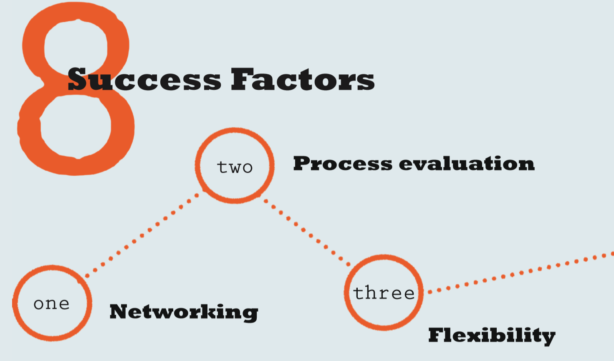
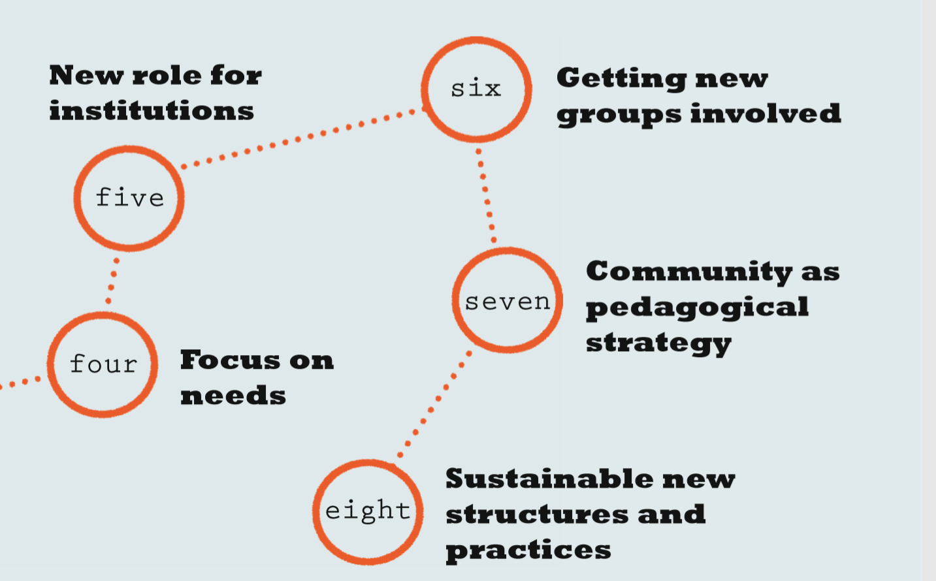
Analysis of Nordic educational projects designed to meet challenges in society. Defining the success factors.
Developed by Jyri Manninen (University of Eastern Finland), Hróbjartur Árnason (University of Iceland), Anne Liveng (Roskilde University in Denmark) and Ingegerd Green (freelance consultant, Sweden) within the framework of the NVL’s Competence Project 2009–2012.

Slide 25
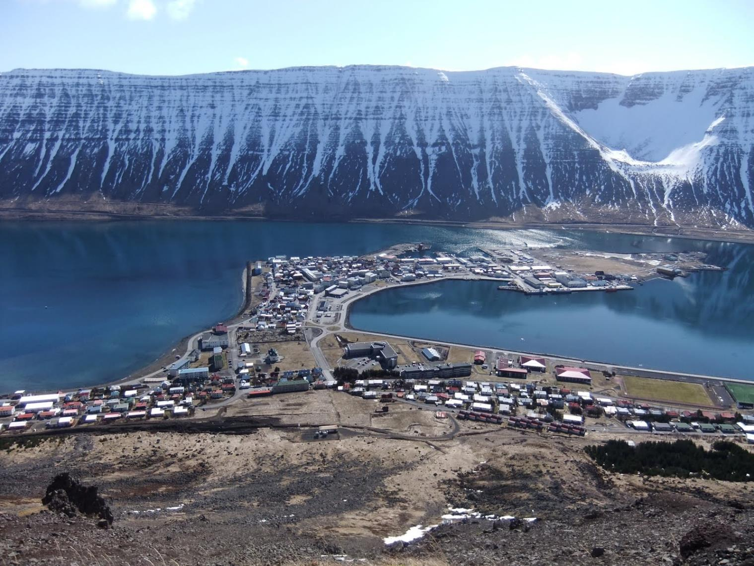
PaaD success factors 1
Commitment and engagement from all interested parties to a shared vision
Local meeting places as hubs for educational activities
Efficient and flexible systems for supporting learners wherever they are

Slide 26
PaaD success factors 2
Learners must feel part of a community and know where to get help
Educational institutions need financial incentives to offer flexible learning
Projects must be broadly rooted in local community, not just between project members
Technology offers many opportunities but the social context is crucial for success

Slide 27
Recommendations
Long-term funding and incentives
Regional alliances and collaboration
Incentives to educational institutions
Better matching between HEIs and local needs

Slide 28
University of the highlands and Islands
13 partners
Further + Higher Education colleges
Specialist colleges
Research institutions
Around 75 learning centres
Linked by technology and a mission

Slide 29
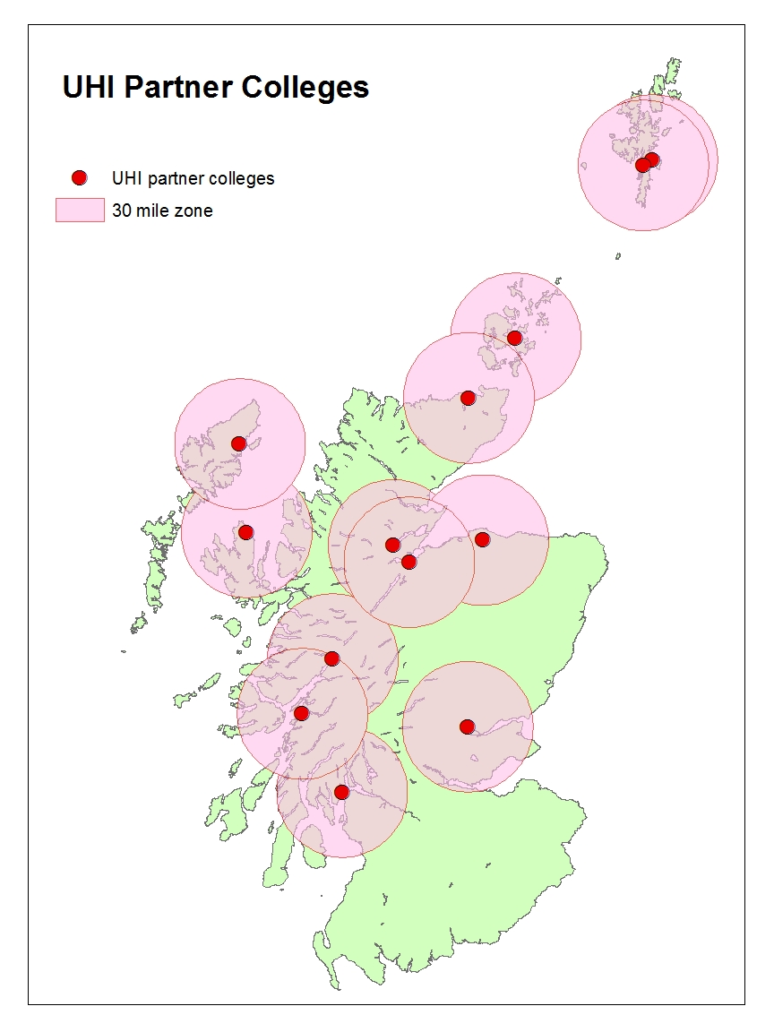
Never more than 30 miles from...
Single site specialisms
20 degrees (regional core)
10 Masters programmes
Vocationally focussed HNCs
Work-based learning / CPD
FE and links to schools

Slide 30
Strategic vision
The University of the Highlands and Islands is the UK’s leading integrated university, encompassing FE and HE.
We will be recognised for the quality of our students’ experience and for their achievement.
Our reputation will be built upon our innovative approach to learning and our distinctive research and curriculum, enriched by the people, natural environment, economy, culture and heritage of our region and its communities.
We will be locally based, regional in structure, and have national and international reach.

Slide 31
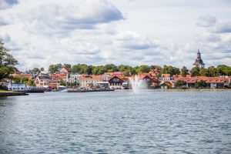
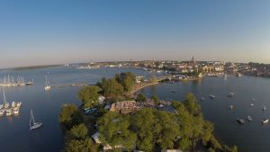
Konferens Nya vägar för flexibilitet i högre utbildning Västervik, 13-14 maj 2020 http://nyavagar.se

