Slide 1
Learning analytics (læringsdata)
En implementerings case

Slide 2
Eksisterer i perioden 01.03.20 - 28.02.24
NurseEd er et udviklings- og forskningsprojekt på Professionshøjskolen Absalon, der udvikler og afprøver en helt ny måde at uddanne sygeplejersker på.
Målet er nyuddannede sygeplejersker, der både har et dybere fagligt vidensniveau og bedre praktiske færdigheder inden for sygepleje.
Innovationsfonden har investeret 17,2 millioner kroner i projektet.

Slide 3
Hvad er læringsdata?
Forstå hvordan studerende lærer for at optimere processen
Learning Analytics
En metode, hvor data - typisk om studerende - indsamles om deres interaktion med læremidler, hinanden og deres underviser med det formål, at understøtte en læreproces.
“[T]he use, assessment, elicitation and analysis of static and dynamic information about learners and learning environments, for the near real-time modelling, prediction and optimization of learning processes, and learning environments, as well as for educational decision-making” (ifenthaler, 2015)
Educational Data Mining
Prædiktiv modellering og udarbejdelse af statistiske modeller fra store datasæt.
Academic Analysis
Analyse af uddannelser (data) på et institutionelt, regional og nationalt niveua.
Mohamed Amine Chatti, Anna Lea Dyckhoff, Ulrik Schroeder, and Hendrik Thüs. 2012. A reference model for learning analytics. Int. J. Technol. Enhanc. Learn. 4, 5/6 (January 2012), 318–331. https://doi.org/10.1504/IJTEL.2012.051815
Lockyer, L., Heathcote, E., & Dawson, S. (2013). Informing Pedagogical Action: Aligning Learning Analytics With Learning Design. American Behavioral Scientist, 57(10), 1439-1459. https://doi.org/10.1177/0002764213479367
Baker, R., & Siemens, G. (2014). Educational Data Mining and Learning Analytics. In R. Sawyer (Ed.), The Cambridge Handbook of the Learning Sciences (Cambridge Handbooks in Psychology, pp. 253-272). Cambridge: Cambridge University Press. doi:10.1017/CBO9781139519526.016
Ifenthaler, D. (2015). Learning analytics. In J. M. Spector (Ed.), The SAGE encyclopedia of educational technology (Vol. 2, pp. 447–451). Thousand Oaks, CA: Sage

Slide 4
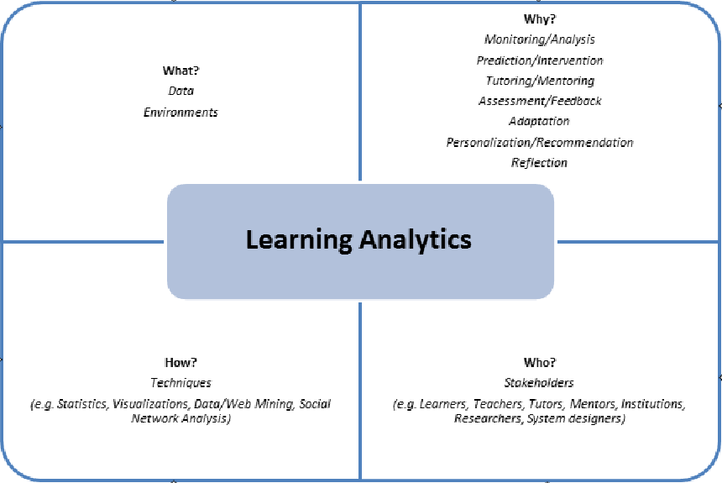
Hvad består det af?
What? Hvilken type data indsamler, administrerer og bruger systemet til analysen?
Who? Hvem er målet for analysen?
Why? Hvorfor analyserer systemet de indsamlede data?
How? Hvordan udfører systemet analysen af de indsamlede data?
Mohamed Amine Chatti, Anna Lea Dyckhoff, Ulrik Schroeder, and Hendrik Thüs. 2012. A reference model for learning analytics. Int. J. Technol. Enhanc. Learn. 4, 5/6 (January 2012), 318–331. https://doi.org/10.1504/IJTEL.2012.051815

Slide 5
Casen: Rhapsode - NurseEd projektet
Eksempel på variablernes konstruktion
What?
Who? Underviserne
Why? Personalisering af læringen
How?
Data (fra studerende)
Tid | Korrekte svar | Oplevet kompetence (Vidste det, Jeg forstår det nu, Tror jeg forstår, Forstår ikke)
Læringsdata fra platformen er tiltænkt, som forberedelsesstøtte til underviserne.
Studerende forbereder sig på platformen (lektier) og underviseren tilpasser kommende lektion på baggrund af de studerendes præstation.
Tesen: Læringsdata = Større læringsudbytte
Variablerne (til underviseren)
Forventet tidsforbrug | Træfsikkerhed | Bevidst inkompetence
 | Progression | Ubevidst inkompetence
 |  | Bevidst kompetence
 |  | Ubevidst kompetence

Slide 6
Casen: Rhapsode - NurseEd projektet
Eksempel på variablernes konstruktion
What?
Who? Underviserne
Why? Personalisering af læringen
How?
Data (fra studerende)
Tid | Korrekte svar | Oplevet kompetence (Vidste det, Jeg forstår det nu, Tror jeg forstår, Forstår ikke)
Læringsdata fra platformen er tiltænkt, som forberedelsesstøtte til underviserne.
Studerende forbereder sig på platformen (lektier) og underviseren tilpasser kommende lektion på baggrund af de studerendes præstation.
Tesen: Læringsdata = Større læringsudbytte
Variablerne (til underviseren)
Forventet tidsforbrug | Træfsikkerhed | Bevidst inkompetence
 | Progression | Ubevidst inkompetence
 |  | Bevidst kompetence
 |  | Ubevidst kompetence
?

Slide 7
Casen: Rhapsode - NurseEd projektet
Eksempel på variablernes konstruktion
What?
Who? Underviserne
Why? Personalisering af læringen
How?
Data (fra studerende)
Tid | Korrekte svar | Oplevet kompetence (Vidste det, Jeg forstår det nu, Tror jeg forstår, Forstår ikke)
Læringsdata fra platformen er tiltænkt, som forberedelsesstøtte til underviserne.
Studerende forbereder sig på platformen (lektier) og underviseren tilpasser kommende lektion på baggrund af de studerendes præstation.
Tesen: Læringsdata = Større læringsudbytte
Det vil jeg fortælle lidt om
Variablerne (til underviseren)
Forventet tidsforbrug | Træfsikkerhed | Bevidst inkompetence
 | Progression | Ubevidst inkompetence
 |  | Bevidst kompetence
 |  | Ubevidst kompetence
?

Slide 8
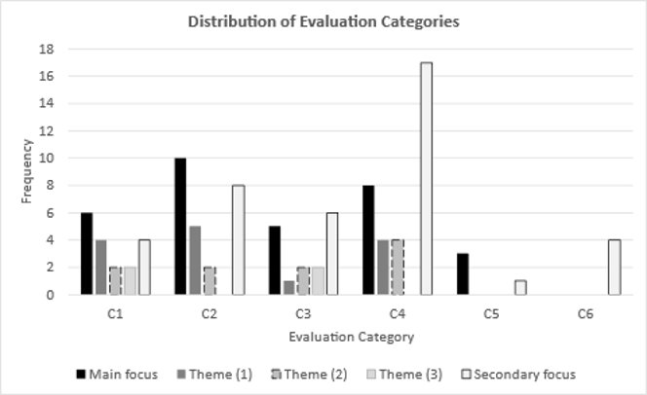
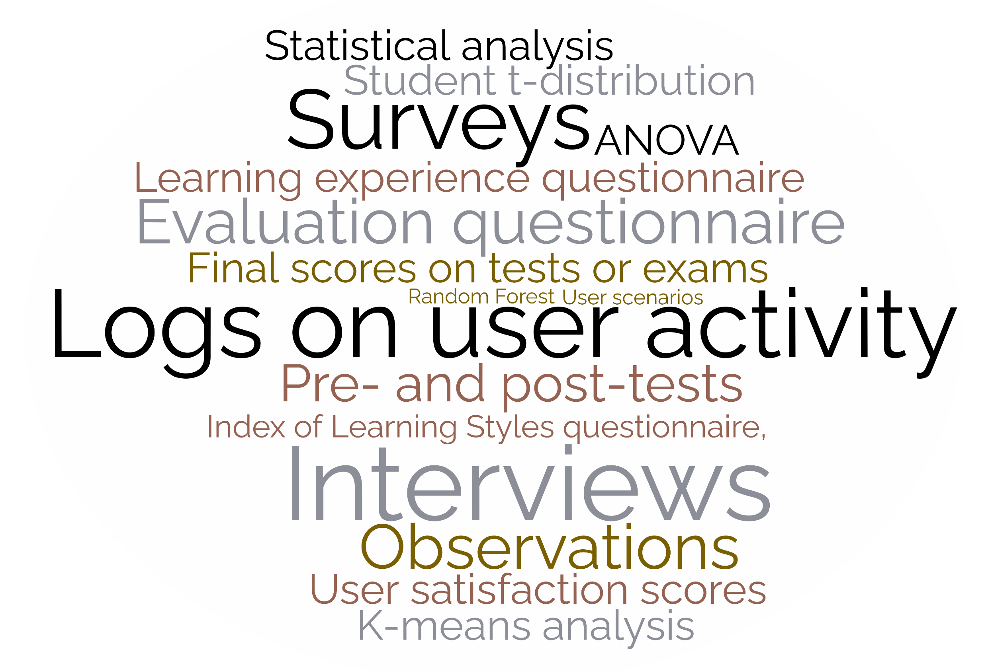
Evaluerings metoder af Adaptive læringsplatformes læringsdata ​ - Systematisk litteratur Review​
C1) Evaluation of LA and LAD design and framework​
Users’ perception of framework and design. ​
System evaluation as a feature of the ALP.​
Requirement and comparative analysis of framework and design.​
C2) Evaluation of user performance with LA and LAD​
Sorting LA content based on user performance. ​
The effect of LA features on user performance.​
C3) Evaluation of adaptivity​
Adaptivity based on psychological inclinations.​
Adaptivity based on users’ affective capabilities.​
Adaptivity based on users’ cognitive capabilities.​
C4) Evaluation of ALPs through perceived value​
Users’ perspectives on usability ​
Self-efficacy elements and learning styles ​
C5) Evaluation of Multimodal methods​
C6) Evaluation of the pedagogical implementation of ALP’s LA and LAD​
Evaluation of ALP’s LA surface, implicit, and deep structures.​
Distributionen af evalueringskategorier fra litteraturen (n=32).
Word Cloud af evalueringsmetoder (n=235) med en frekvens på <1.
Tretow-Fish, T.A.B., Khalid, M.S. (2022). Evaluating Learning Analytics of Adaptive Learning Systems: A Work in Progress Systematic Review. In: Brooks, E., Sjöberg, J., Møller, A.K. (eds) Design, Learning, and Innovation. DLI 2021. Lecture Notes of the Institute for Computer Sciences, Social Informatics and Telecommunications Engineering, vol 435. Springer, Cham. https://doi.org/10.1007/978-3-031-06675-7_3

Slide 9
Hvordan er platformen at bruge?
Studerende (1)
The result is the selection and application of system usability scale (SUS) and co-Discovery with concurrent interviews for the evaluation of RhapsodeTM Learner. The average score of 53.8 (n = 15) shows low marginal acceptability with good internal consistency (10 items, Cronbach’s = 0.863).
Undervisere (2)
Feedback from the tests on the prototypes receives positive feedback from all teacher personas. The teacher persona of Niels Novice also supplies a criticism of the insights and recommended actions on the basis of creating undesired interpretation, potential bias, taking away freedom of interpretation, and authoritative system that “instructs/orders” action.
Khalid, M.S., Tretow-Fish, T.A.B., Roark, A. (2023). Usability Evaluation of Adaptive Learning System RhapsodeTM Learner. In: Ahmad, M., Uddin, M.S., Jang, Y.M. (eds) Proceedings of International Conference on Information and Communication Technology for Development. Studies in Autonomic, Data-driven and Industrial Computing. Springer, Singapore. https://doi.org/10.1007/978-981-19-7528-8_6
Tretow-Fish, T.A.B., Khalid, M.S., Leweke, V.A.C. (2023). Prototyping the Learning Analytics Dashboards of an Adaptive Learning Platform: Faculty Perceptions Versus Designers’ Intentions. In: Zaphiris, P., Ioannou, A. (eds) Learning and Collaboration Technologies. HCII 2023. Lecture Notes in Computer Science, vol 14040. Springer, Cham. https://doi.org/10.1007/978-3-031-34411-4_36

Slide 10
Hvordan bruges platformen?
Tilpasning af undervisning til lektierne
Two-way ANOVA analysis revealed that 3rd-semester students outperformed 4th-semester students, with no significant difference between the test and control groups. Survey results indicated that 3rd-semester students, facing technical issues, had a less satisfactory experience with adjusted lectures. Qualitative analysis of comments showed mixed opinions across groups, encompassing issues with content, teaching improvements, and a need for ALP features. Notably, 3rd-semester students sought study guidance, while 4th-semester students believed the ALP possessed qualities to support homework. Overall, this study sheds light on the complex interplay between ALPs, lecture adjustments, and student experiences in a nursing education context.
Paper is currently in review

Slide 11
Effekten af platformen?
Effekten af platformen på studerendes performance
Performing the two-sample t-test to compare post-test scores of students with progression 0-25%, 25 - 50%, 50-75%, 75-100%, and the control group, significant difference was found in the performance of the 75-100% group (Mean = 60.15, SD = 22.26) and the control group (Mean = 50.55 SD = 18.82); p = 0.03. Furthermore, significant difference was found in the performance of the 0-25% group (Mean = 39.91, SD = 17.18) and the control group; p=0.0006). Not significance 25 - 50% (Mean = 31.63, SD = 17.91) and control group versus control (p=0.01) 50-75% (Mean = 49.21, SD = 17.6) and control group versus control (p=0.73) If we use it less than 50%, we perform worse than control on post-test if we use more than 50%, we perform better on the post-test.
Paper is under development

Slide 12
Effekten af platformen? (fortsat…)
74% (n=146 af 197) af de studerede lykkedes ikke med at komme halvvejs gennem indholdet på platformen.
Paper is under development

Slide 13
Midlertidig konklusion
Brugen er læringsdata (på en adaptiv læringsplatform) er afhængig af:
- Platformens framework (C1)
- De studerendes præstation (C2)
- Platformens adaptivitet (C3)
- Oplevelsen af platformen (C4)
- [Platformens multimodalitet] (C5)
- Den pædagogiske implementering (C6)
- ?

Slide 14
Hvad betyder det at ”lave lektier”?
Our research demonstrates that preparation goes beyond mere adequacy; it encompasses qualitative distinctions. Students' preparation varies based on the types of resources they use, ranging from traditional analog tools to digital technologies. Additionally, preparation exhibits diverse temporal and spatial dimensions. Some students engage in prolonged and intensive sessions, while others divide their preparation into smaller segments. Timing also varies, with students preparing well in advance, right before class, or even after class. Preparatory behaviors may also differ at different stages of the semester, with some students prioritizing early preparation and others focusing on later periods. Importantly, our findings indicate that student preparation elicits a wide range of emotions, although most students express satisfaction. However, it is worth noting that this sense of satisfaction may stem from different underlying factors.
Tretow-Fish, T.A.B, Andersen, B.L., Møller, T.E., Nortvig, A. (accepted 2023) 'What does it mean to prepare for class? A case study on students’ study habits in a nursing educational program’, Journal of Learning Development in Higher Education.

Slide 15
Where?
​
​
Konteksten for implementeringen af læringsdata er også væsentlig at forstå/evaluere førend man kan implementere læringsdata succesfuldt.
C1) Evaluation of LA and LAD design and framework​ | C2) Evaluation of user performance with LA and LAD | C3) Evaluation of adaptivity​
C4) Evaluation of ALPs through perceived value | C5) Evaluation of Multimodal methods​ | C6) Evaluation of the pedagogical implementation of ALP’s LA and LAD​
C7) Context
(*)
LA = Learning Analytics
LAD = Learning Analytic Dashboards
ALP = Adaptive Learning Platforms

Slide 16
Hvad er ‘Where’ så?
Hvordan kan (/skal) vi beskrive og forstå den kontekst vi implementerer i?
Fysisk dimensioner
Kulturelle dimensioner
Adfærds dimensioner

